Slide 1
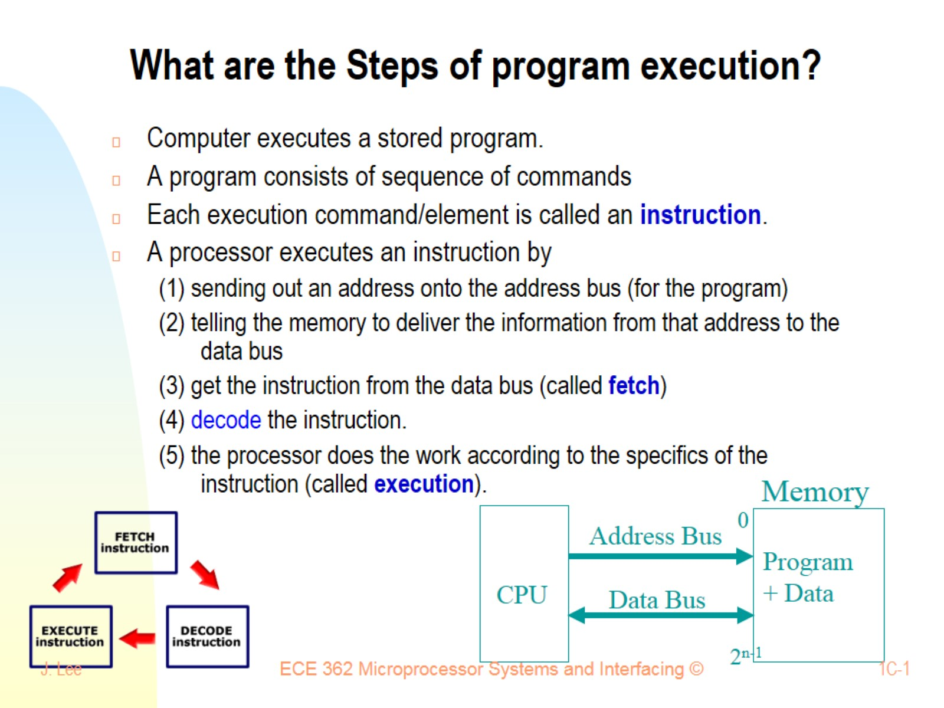
What are the Steps of program execution?

Slide 2
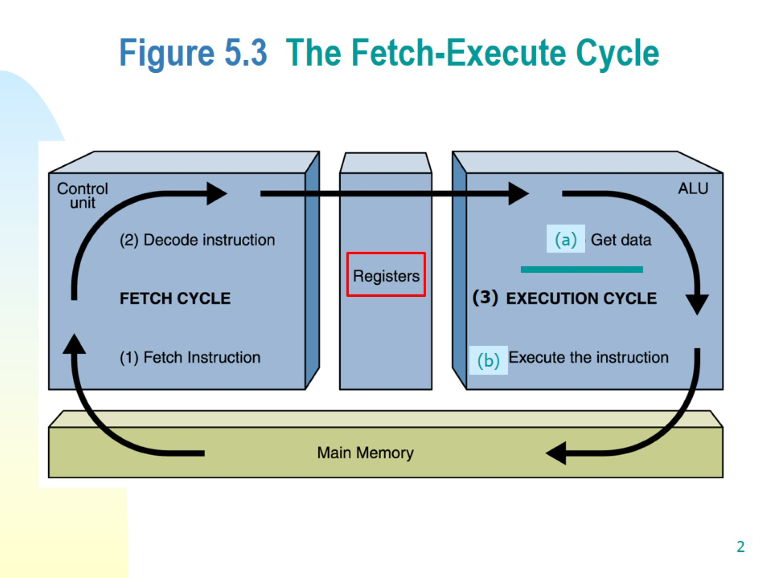
Figure 5.3 The Fetch-Execute Cycle

Slide 3
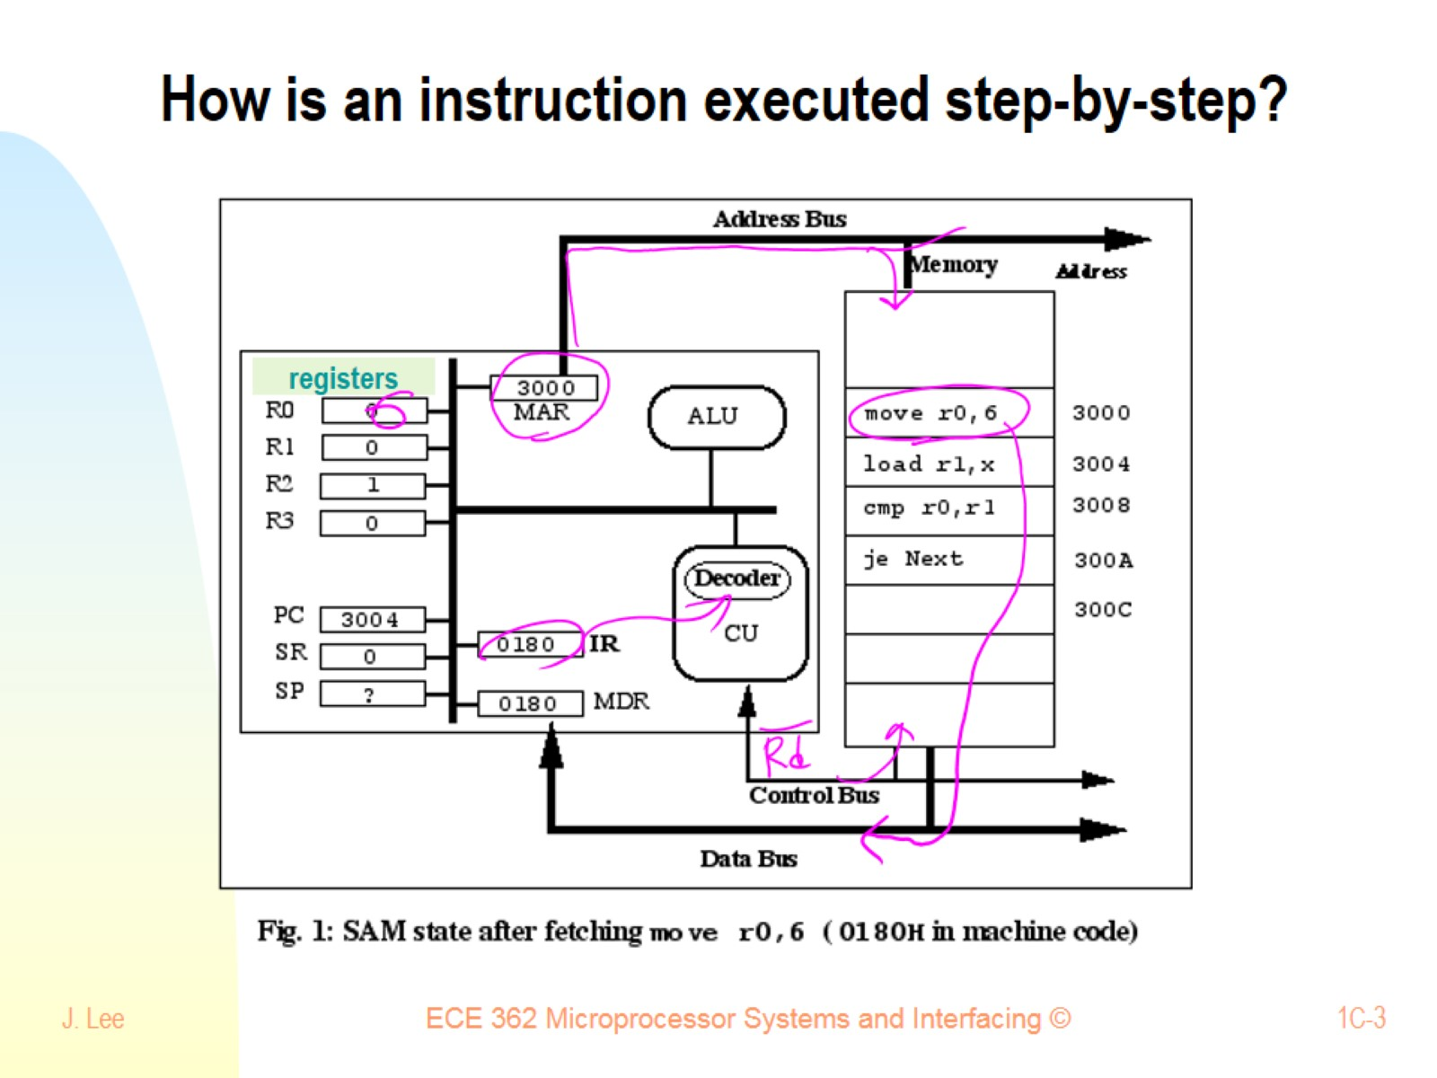
How is an instruction executed step-by-step?

Slide 4
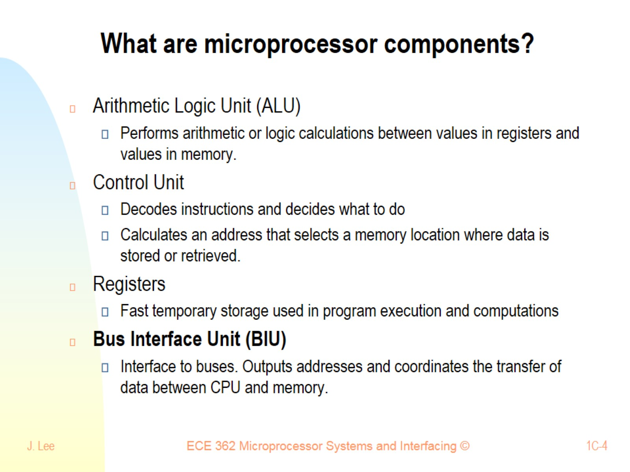
What are microprocessor components?

Slide 5
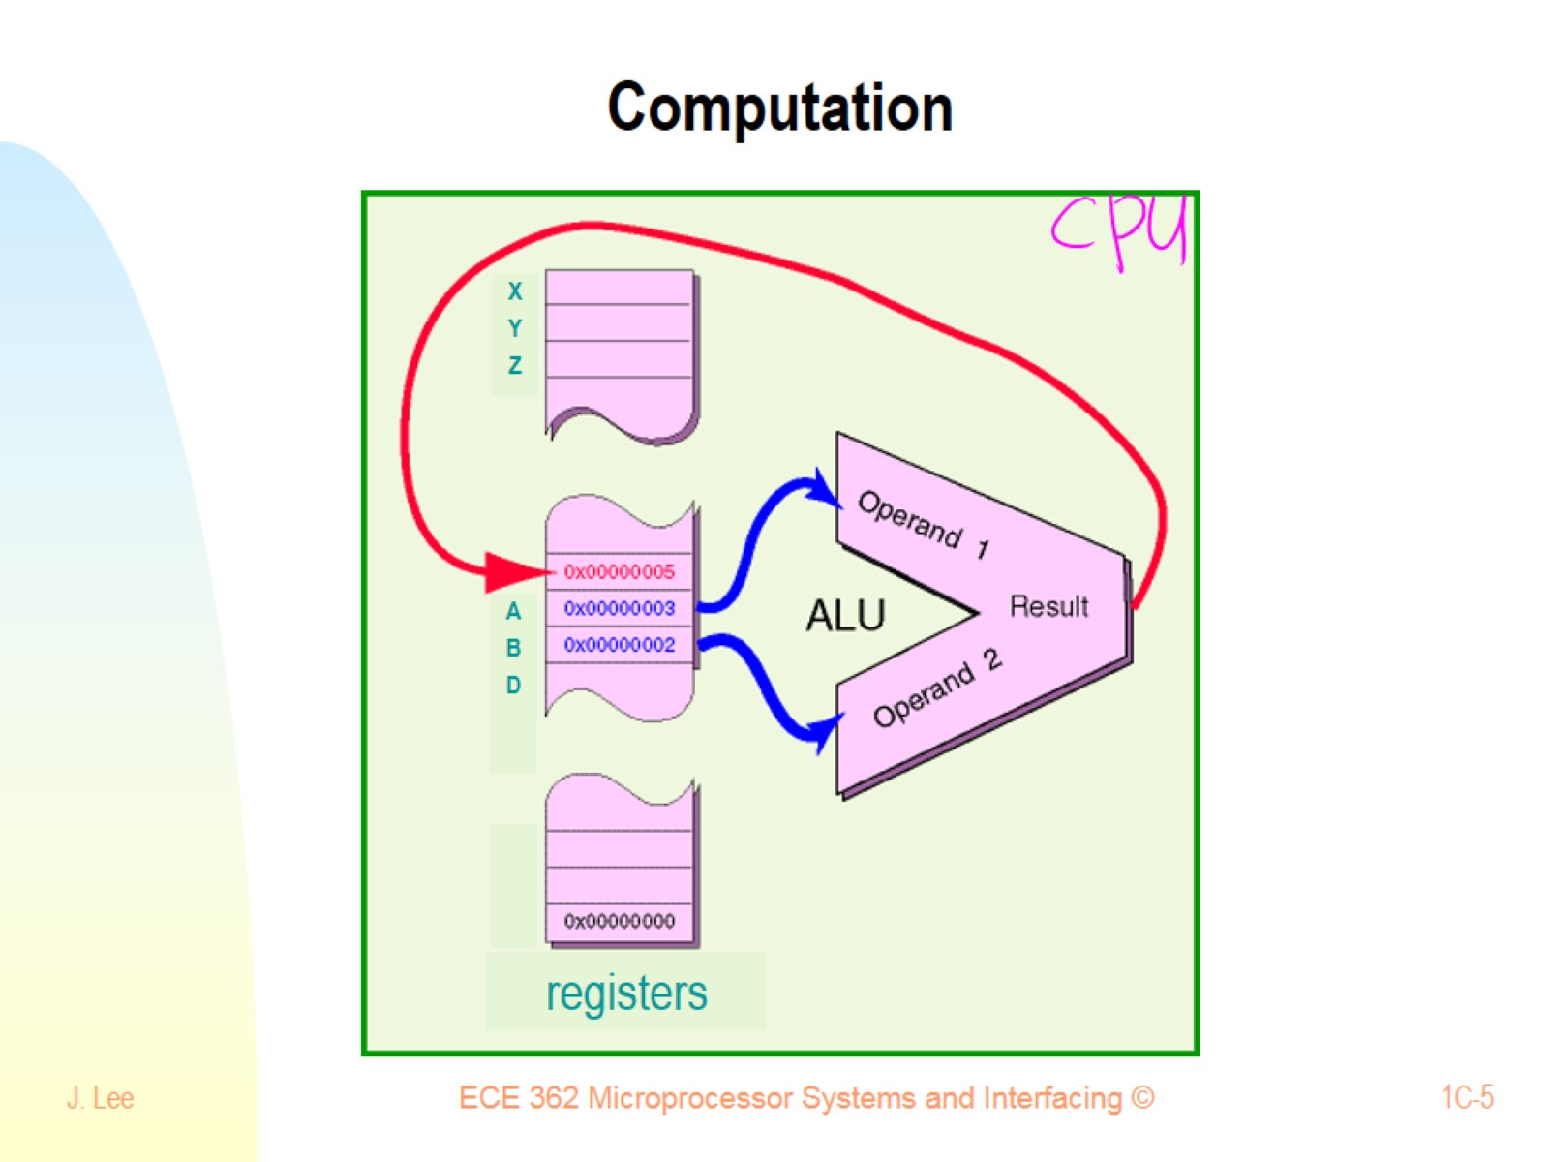
Computation

Slide 6
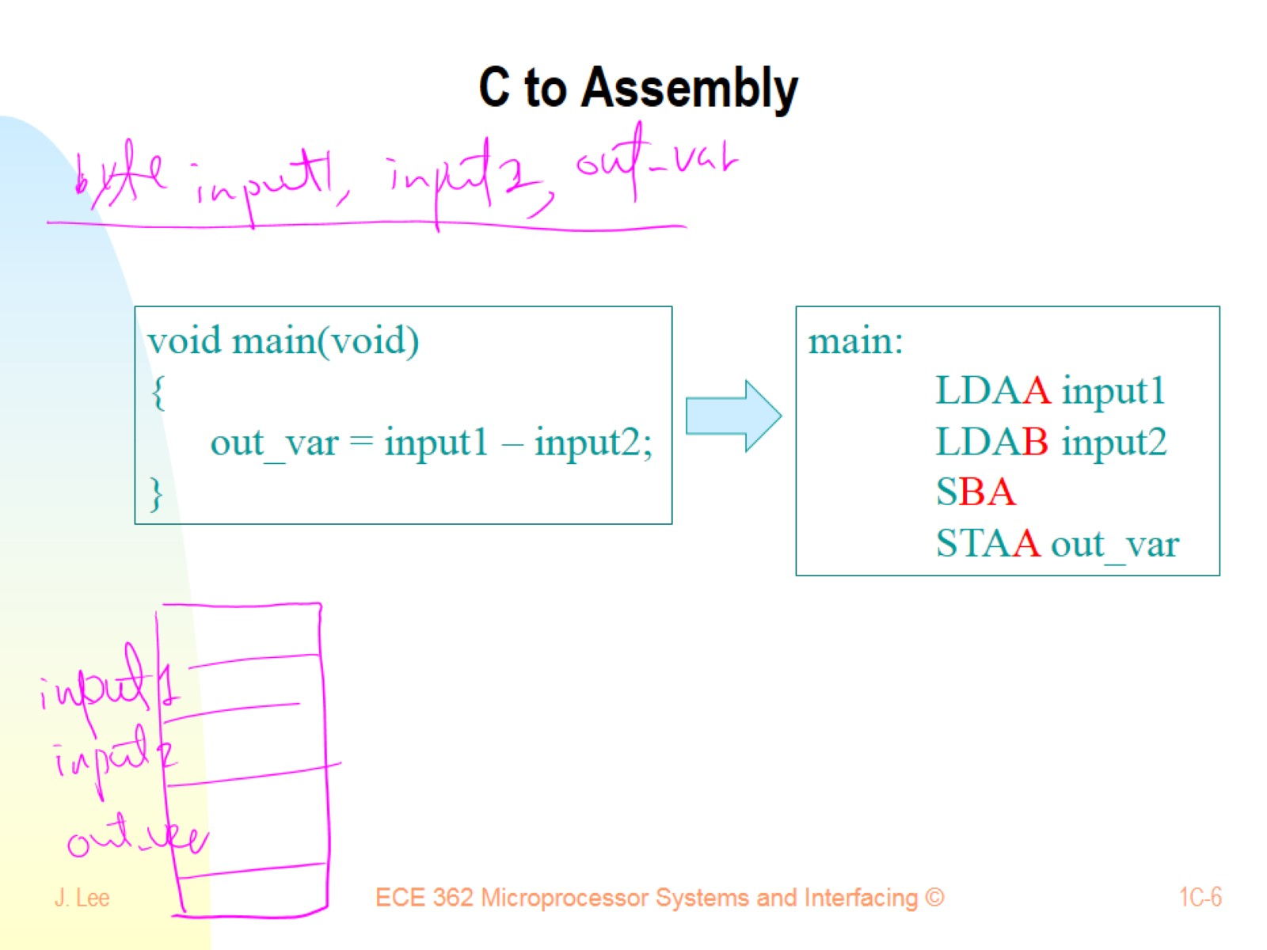
C to Assembly

Slide 7
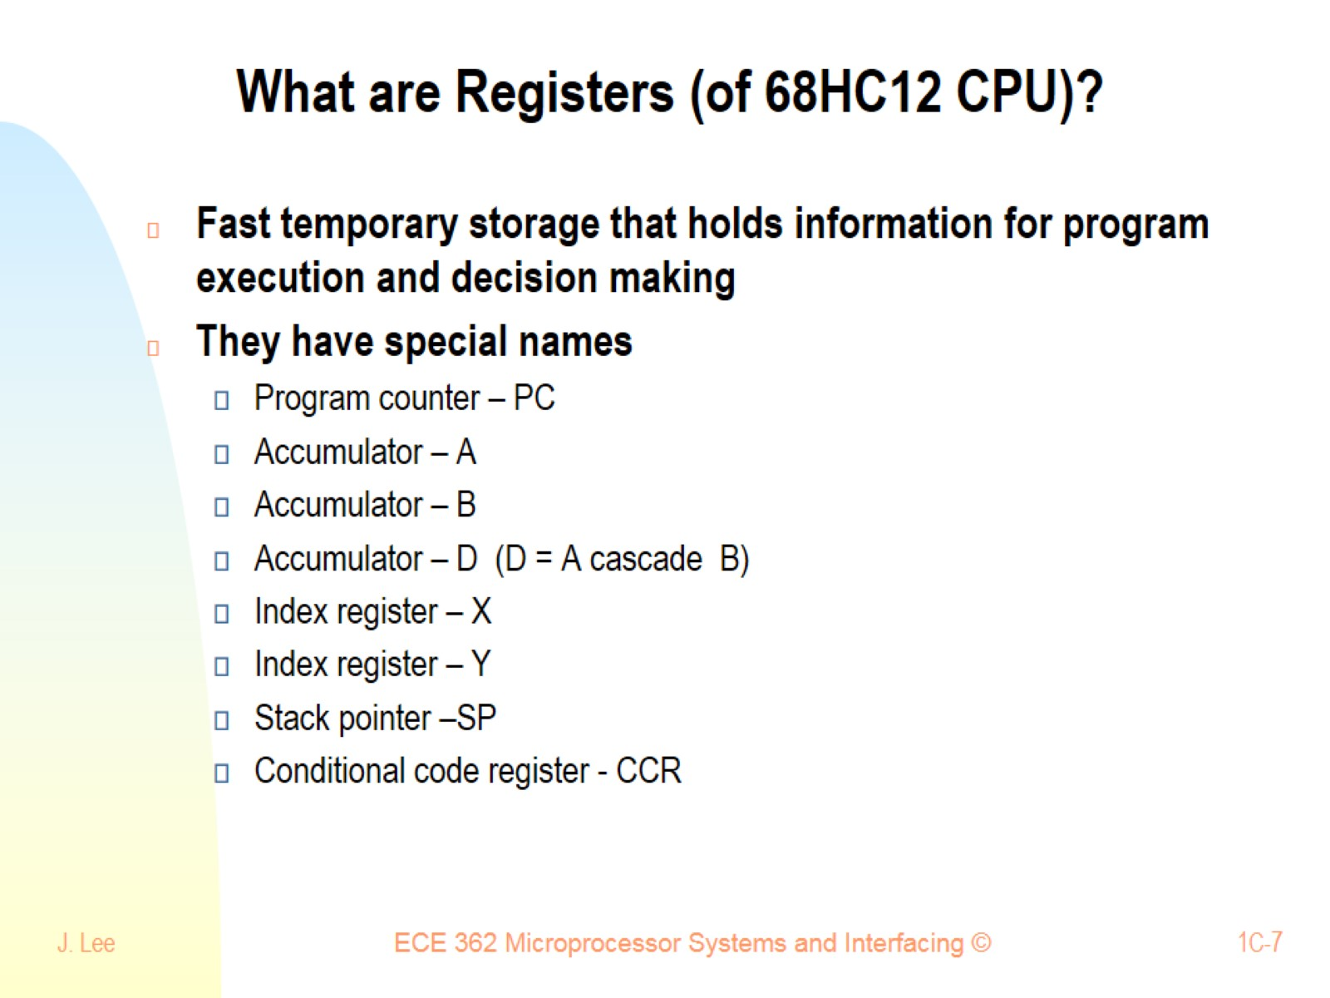
What are Registers (of 68HC12 CPU)?

Slide 8
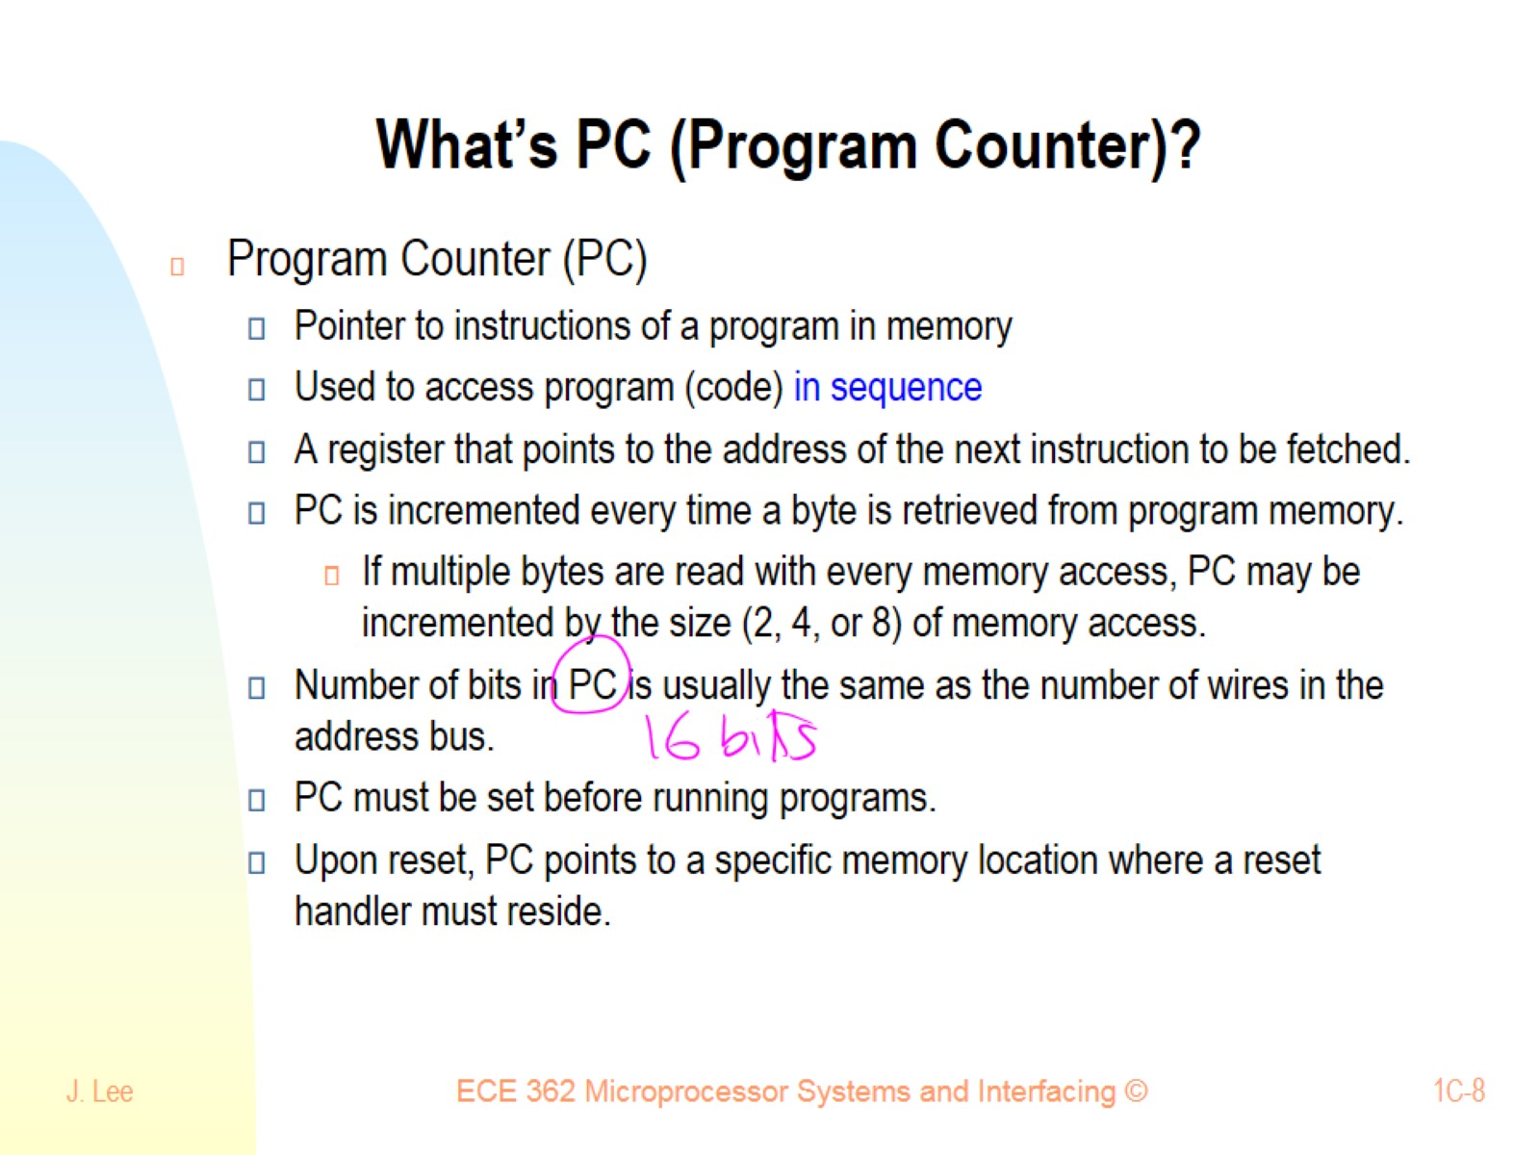
What’s PC (Program Counter)?

Slide 9
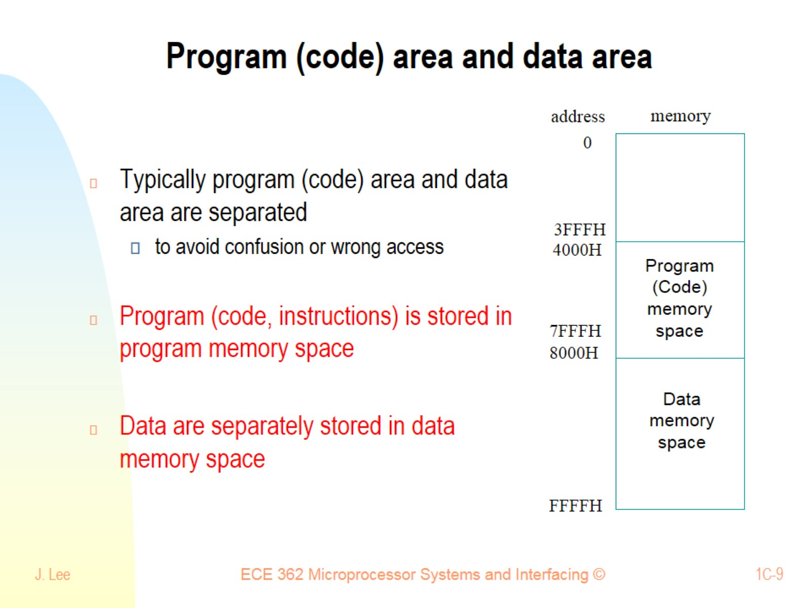
Program (code) area and data area

Slide 10
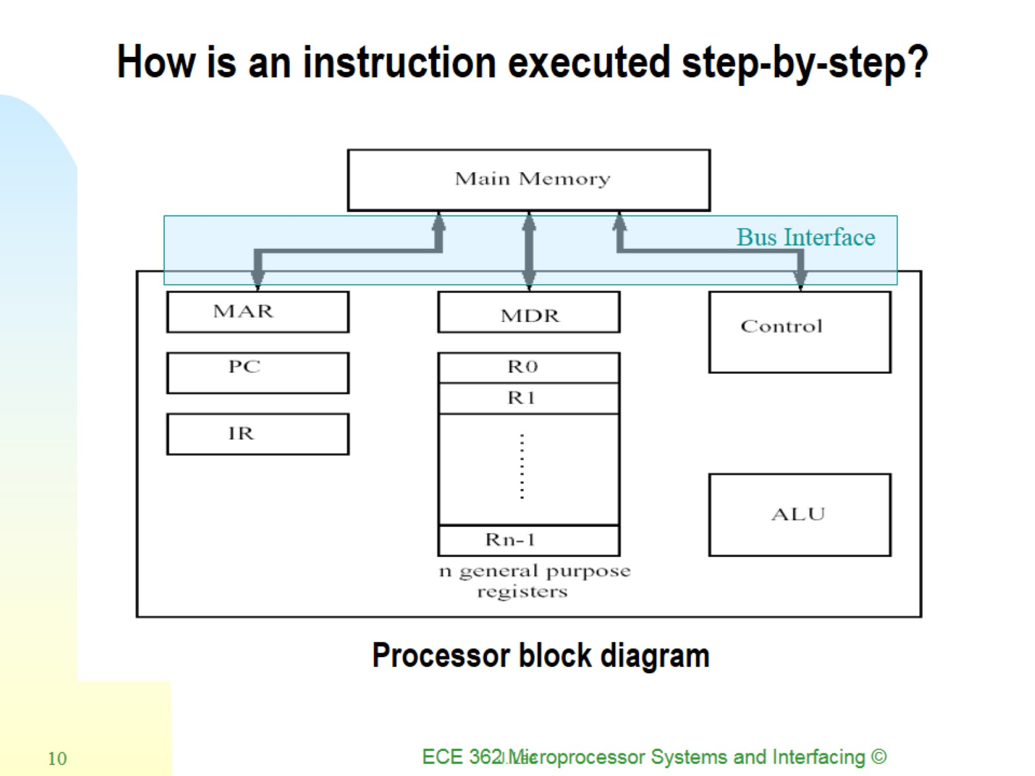
How is an instruction executed step-by-step?

Slide 11
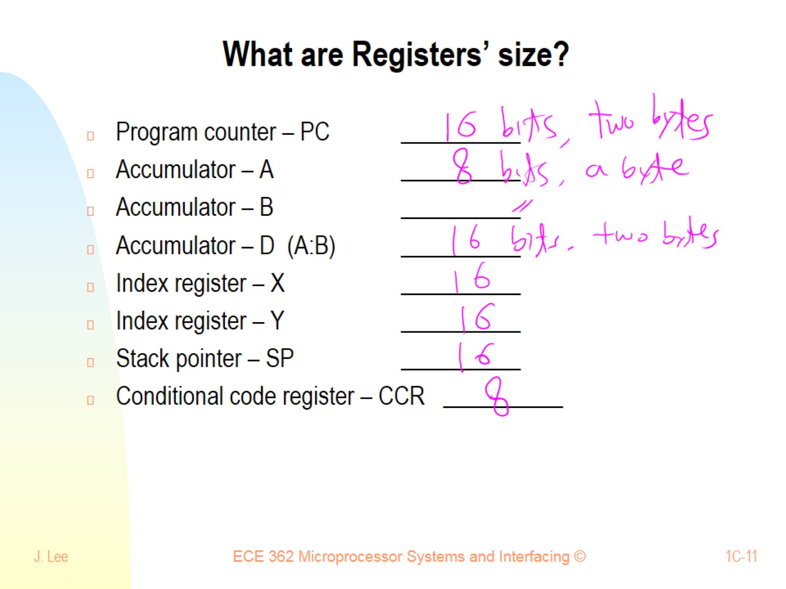
What are Registers’ size?

Slide 12
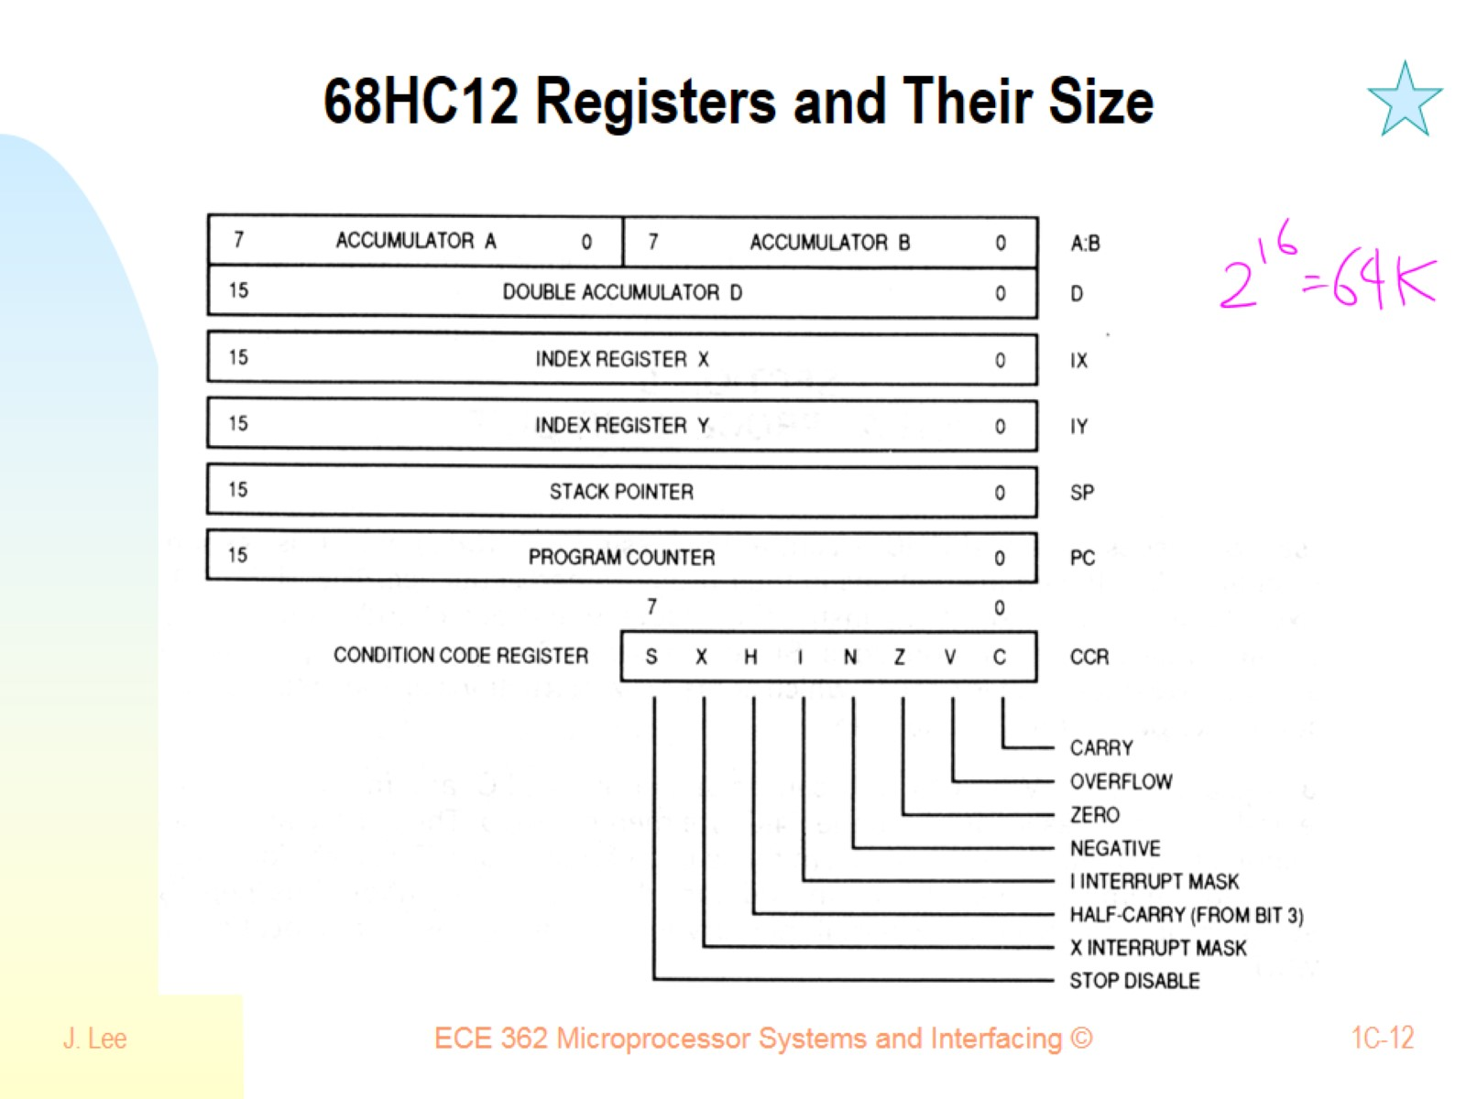
68HC12 Registers and Their Size

Slide 13
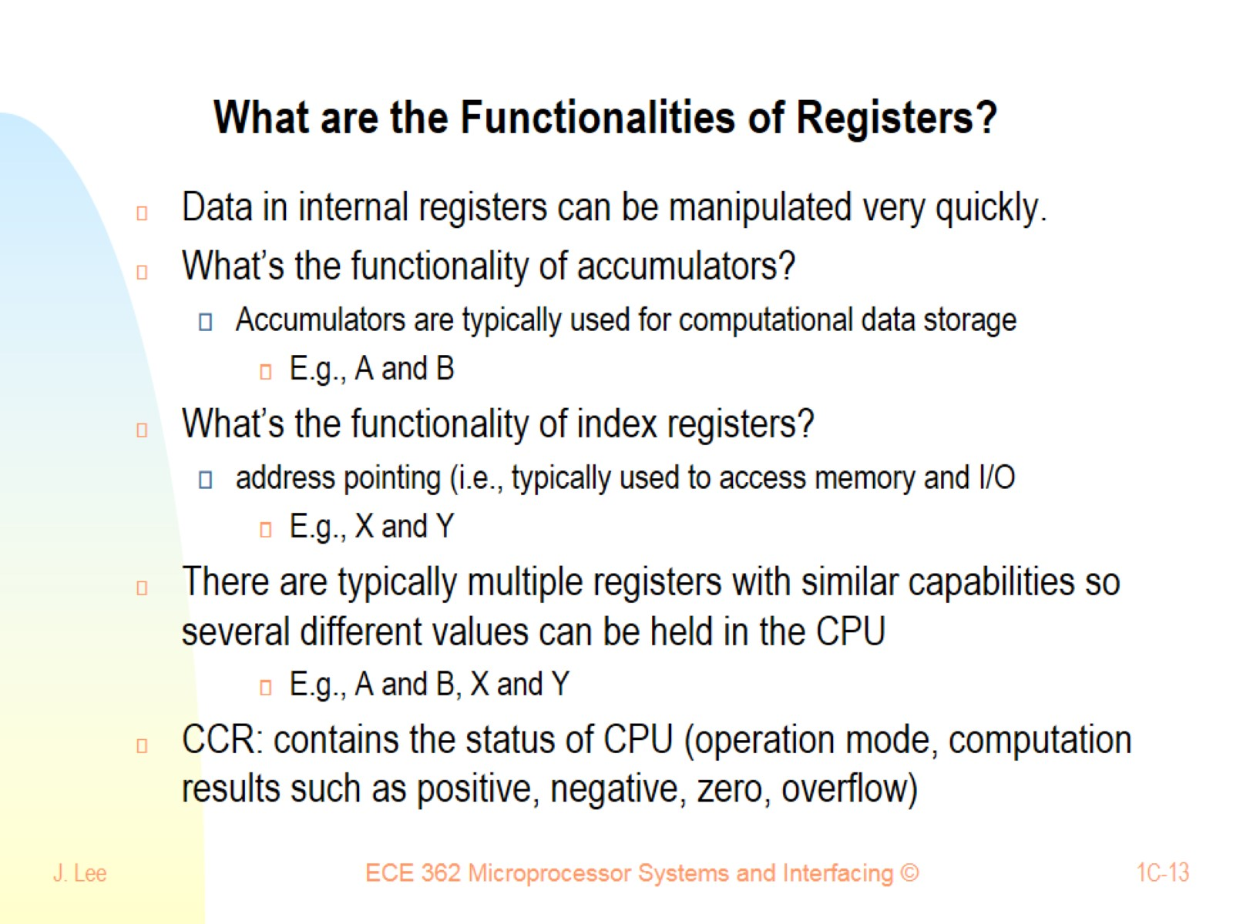
What are the Functionalities of Registers?

Slide 14
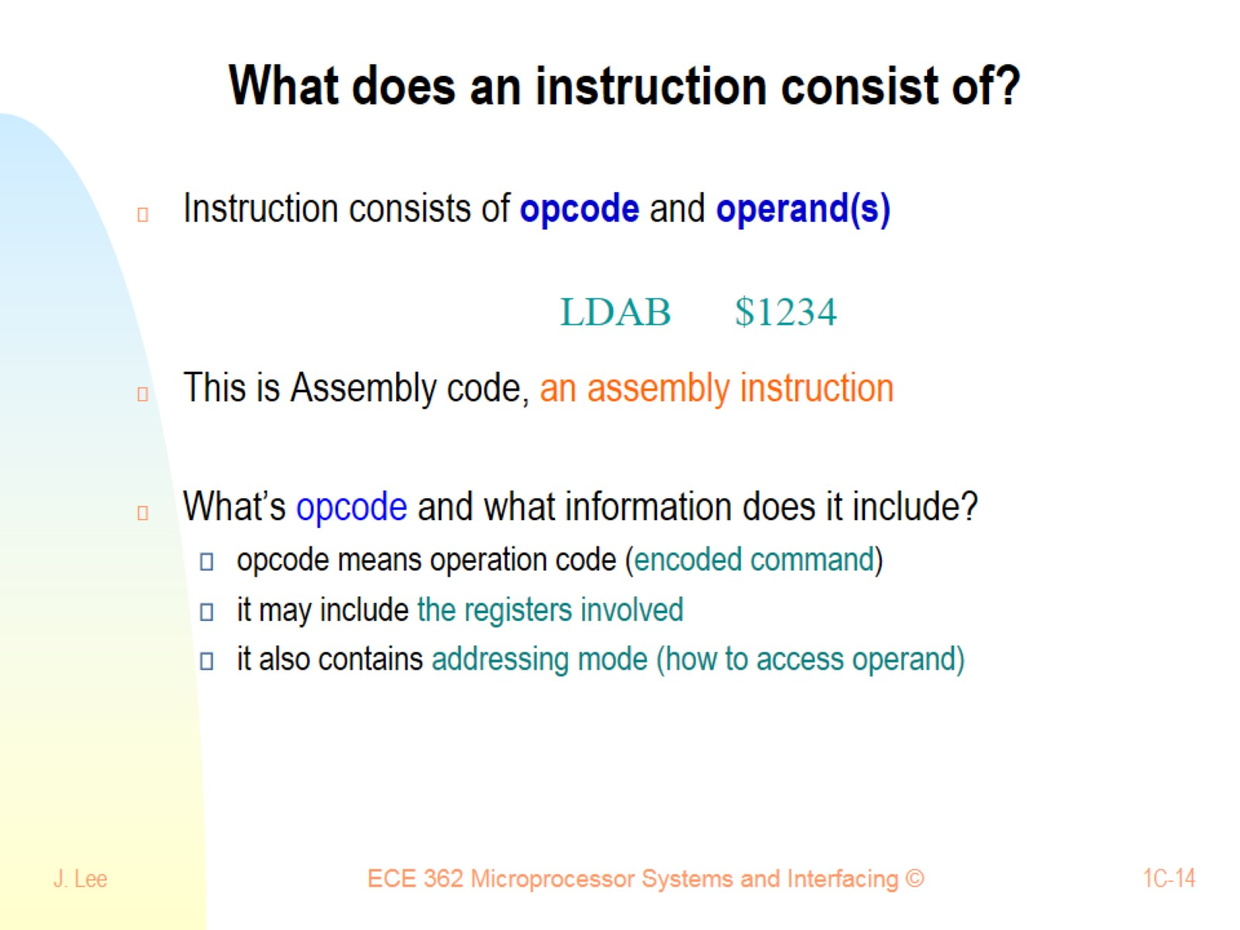
What does an instruction consist of?

Slide 15
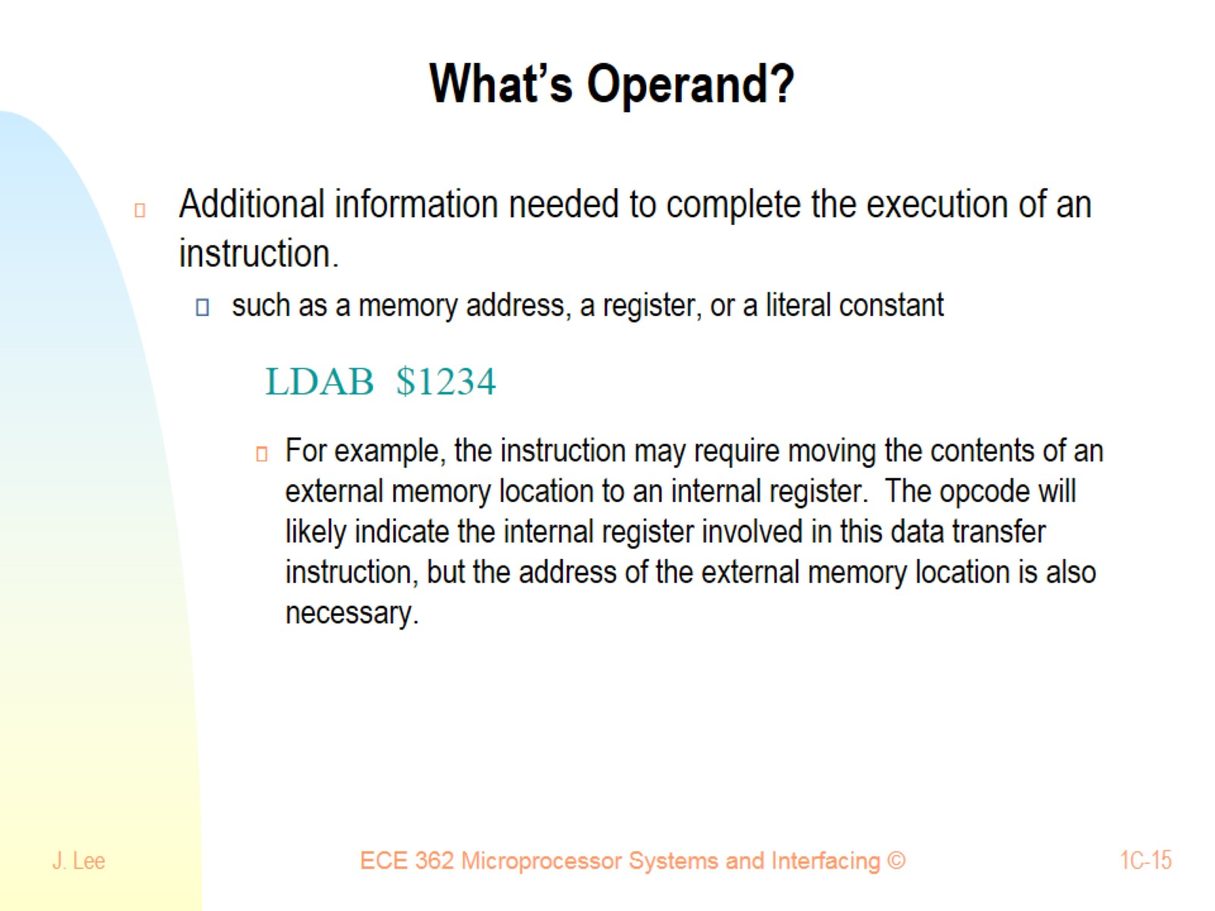
What’s Operand?

Slide 16
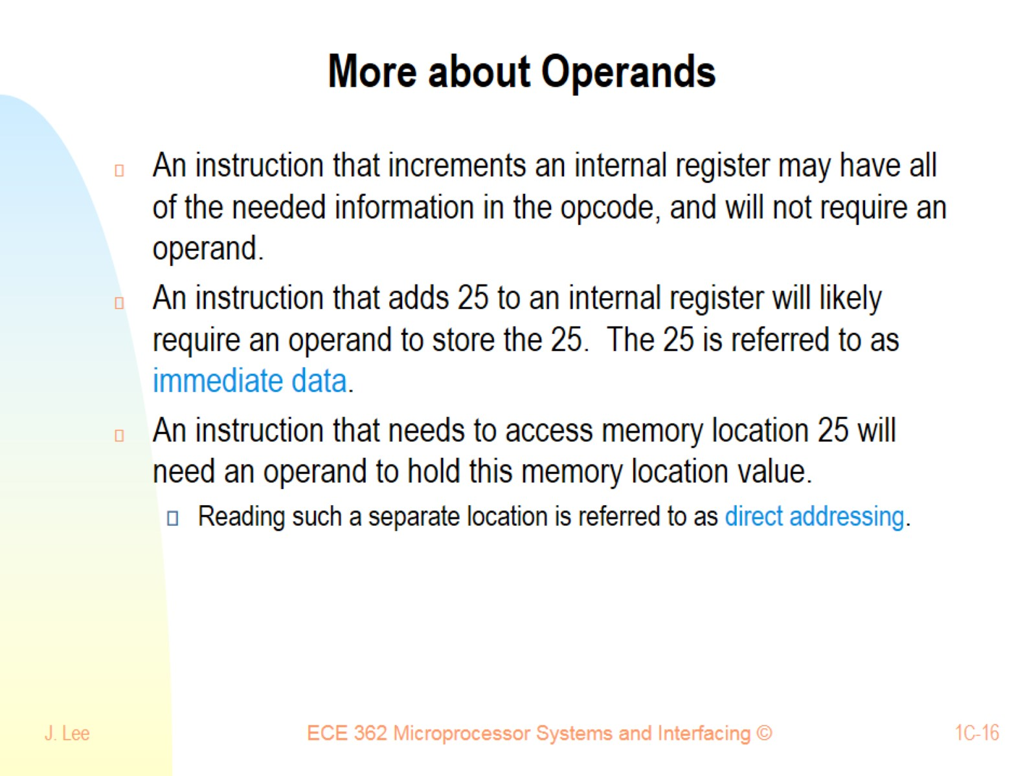
More about Operands

Slide 17
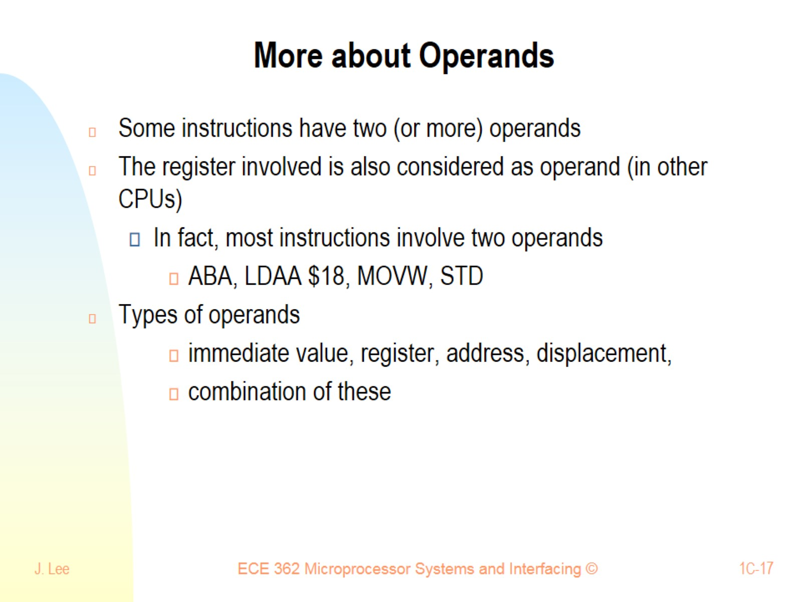
More about Operands

Slide 18
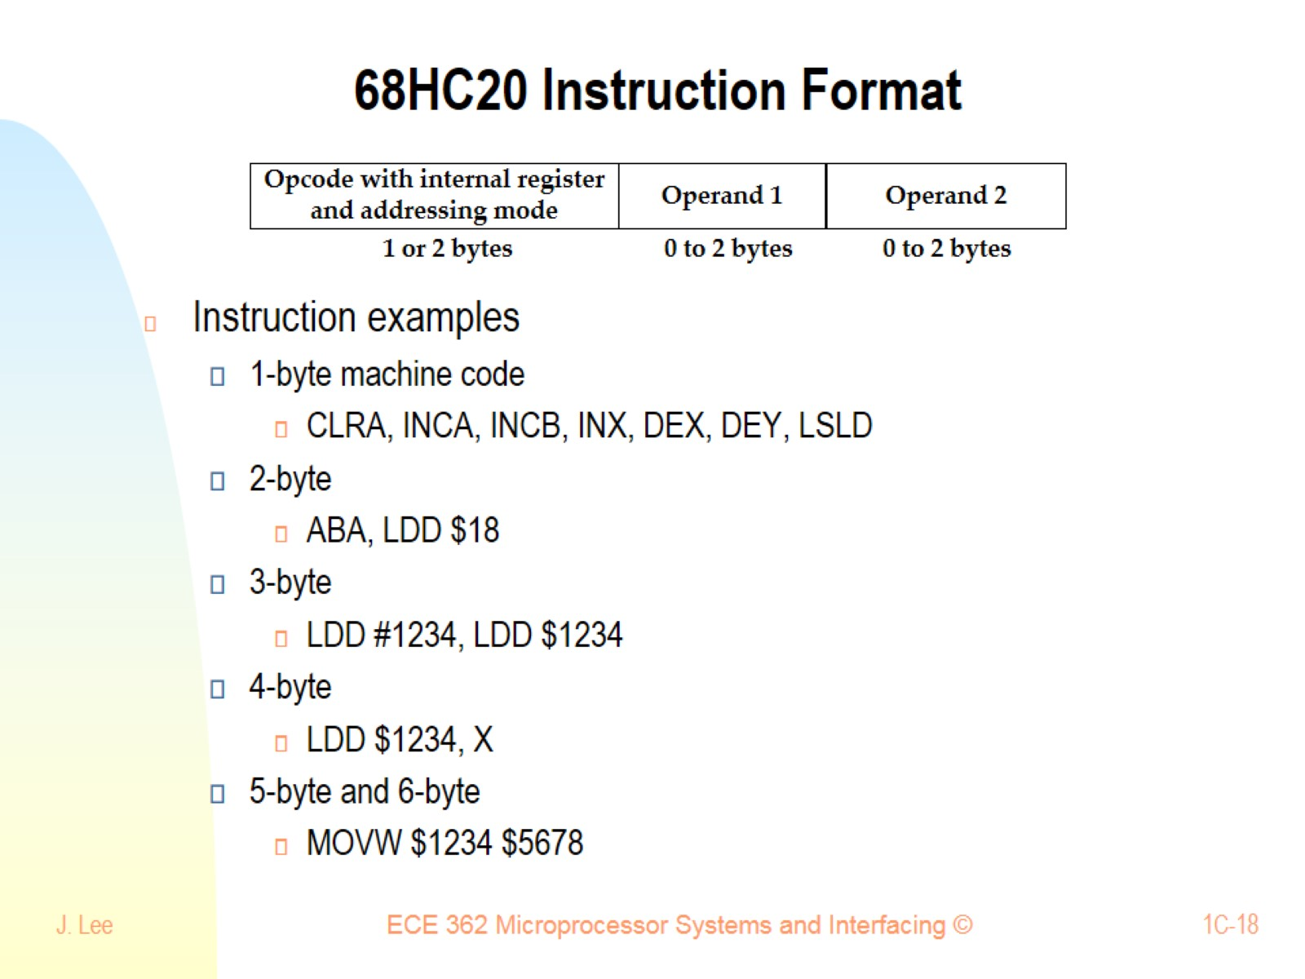
68HC20 Instruction Format

Slide 19
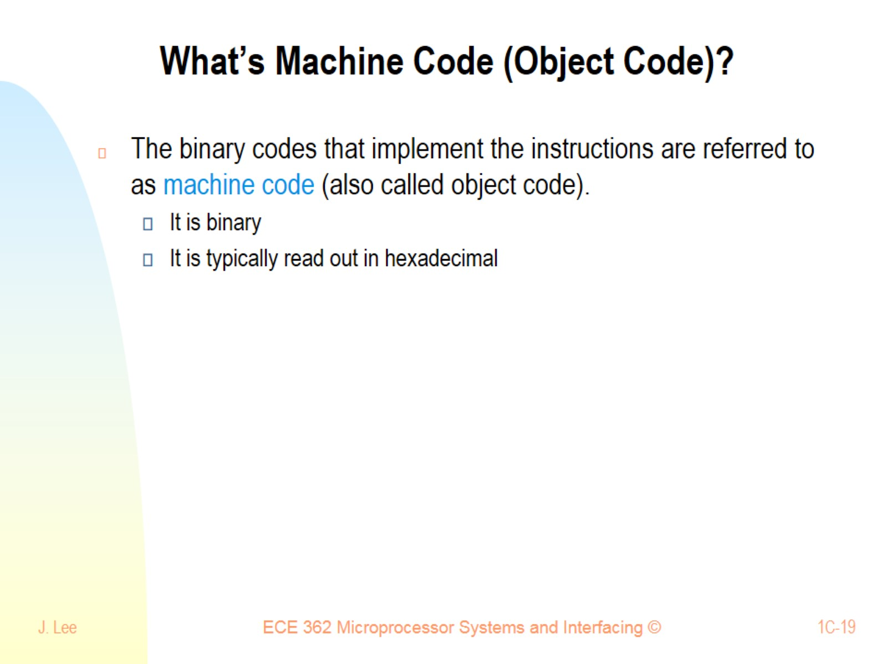
What’s Machine Code (Object Code)?

Slide 20
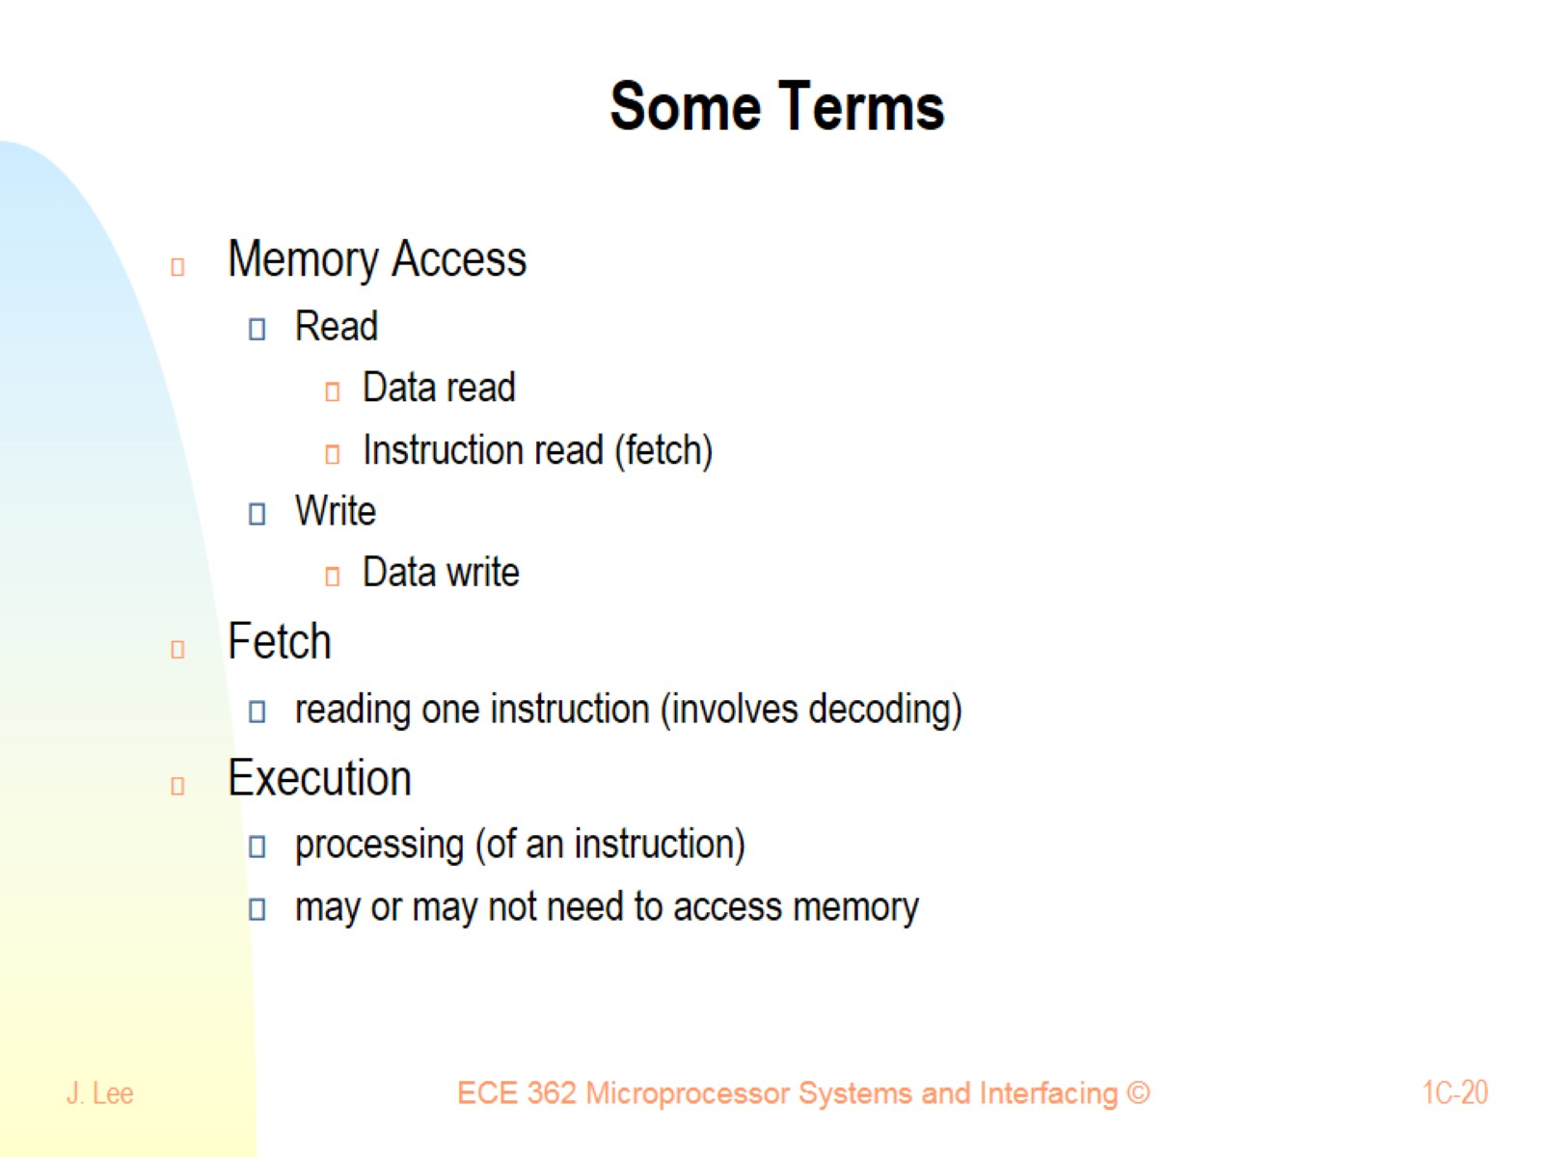
Some Terms

Slide 21
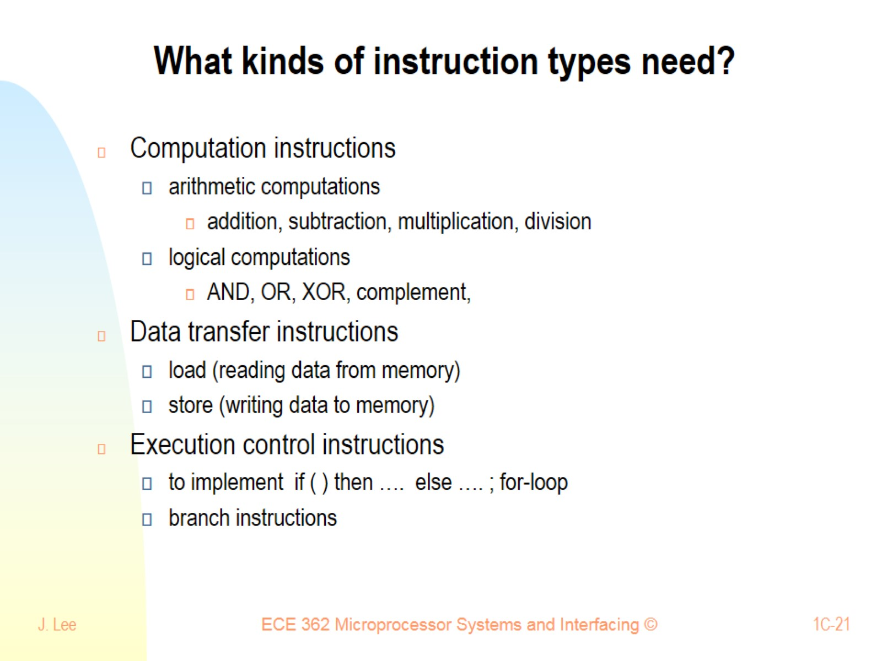
What kinds of instruction types need?

Slide 22
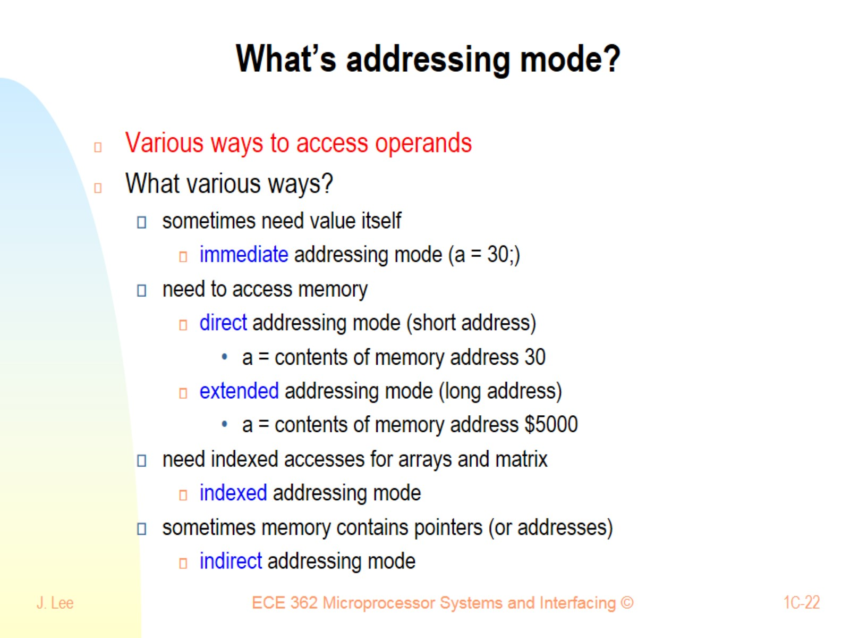
What’s addressing mode?

Slide 23
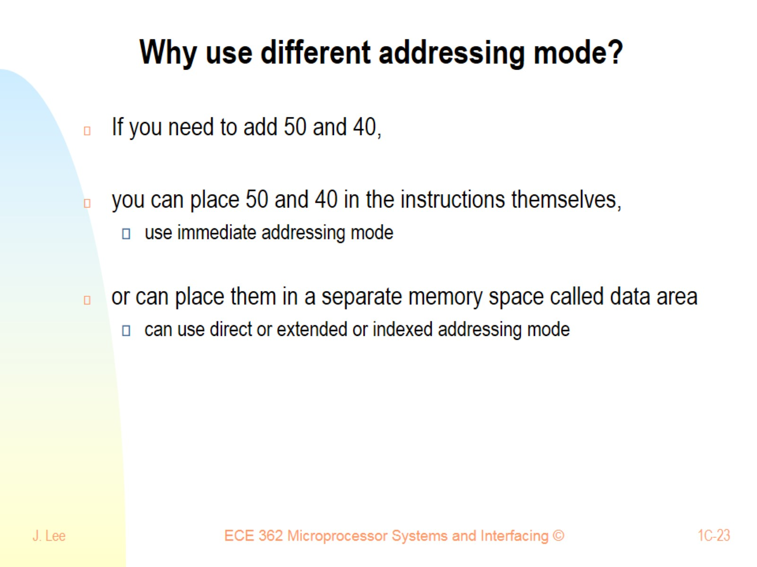
Why use different addressing mode?

Slide 24
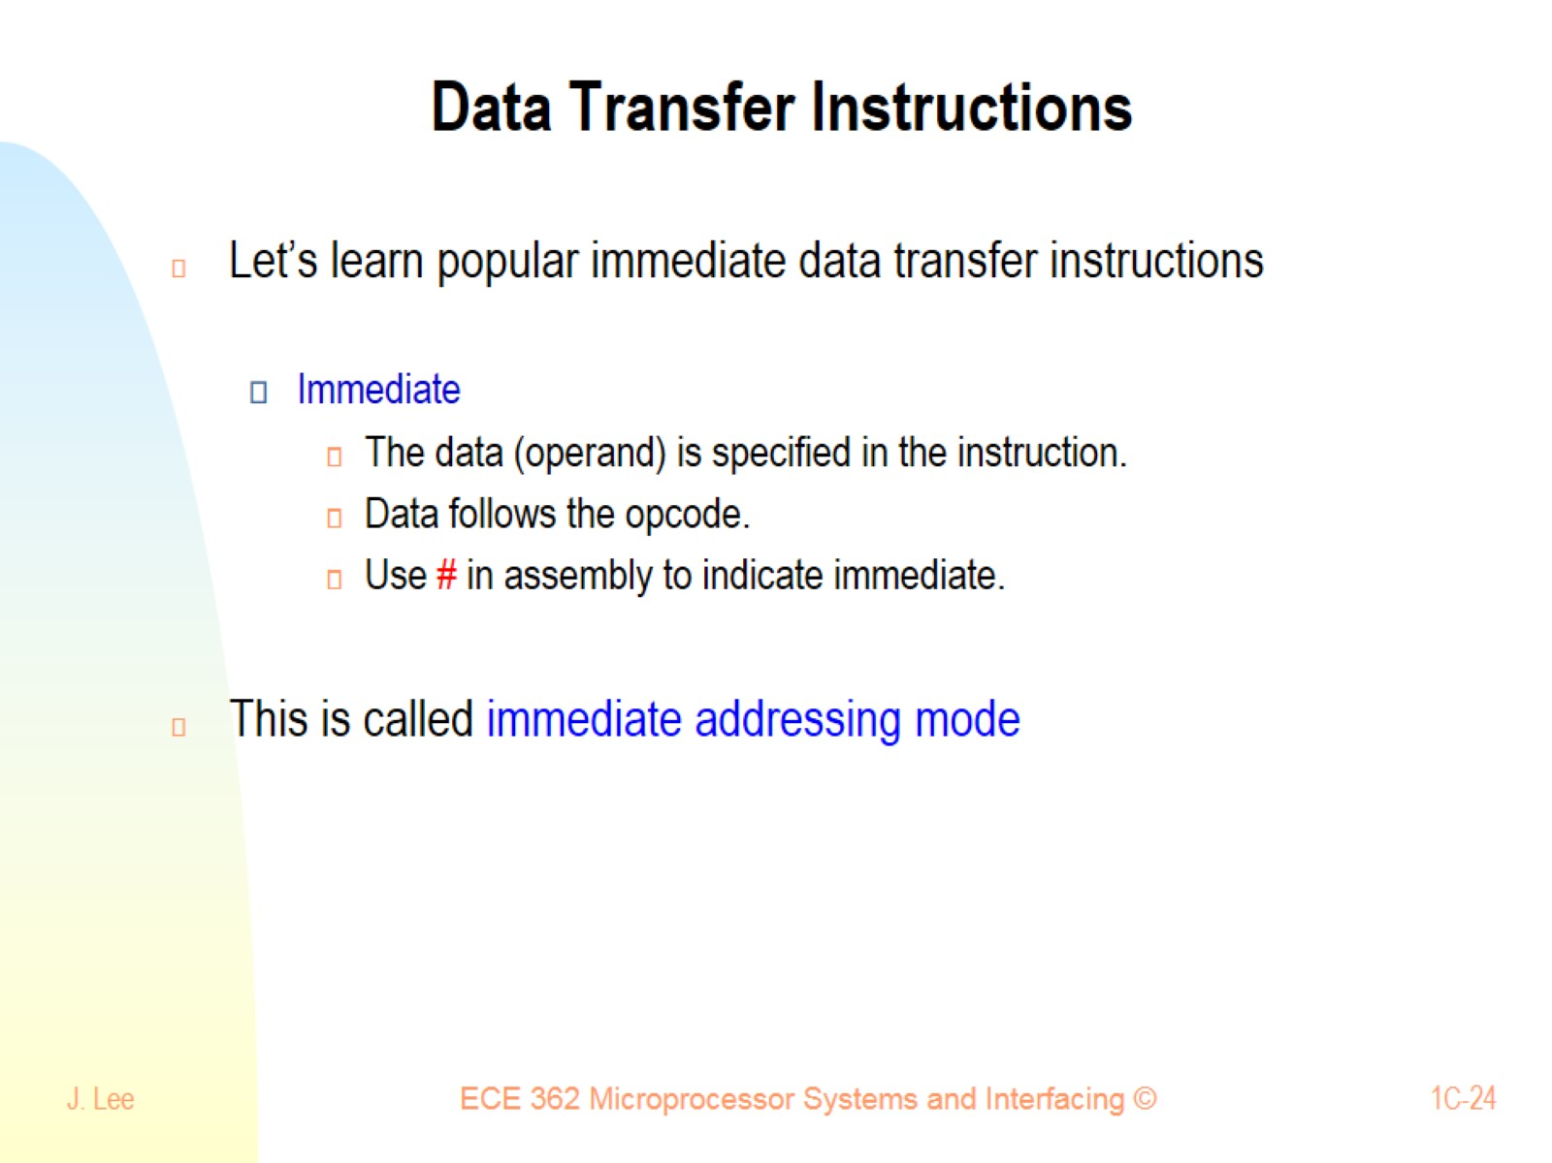
Data Transfer Instructions

Slide 25
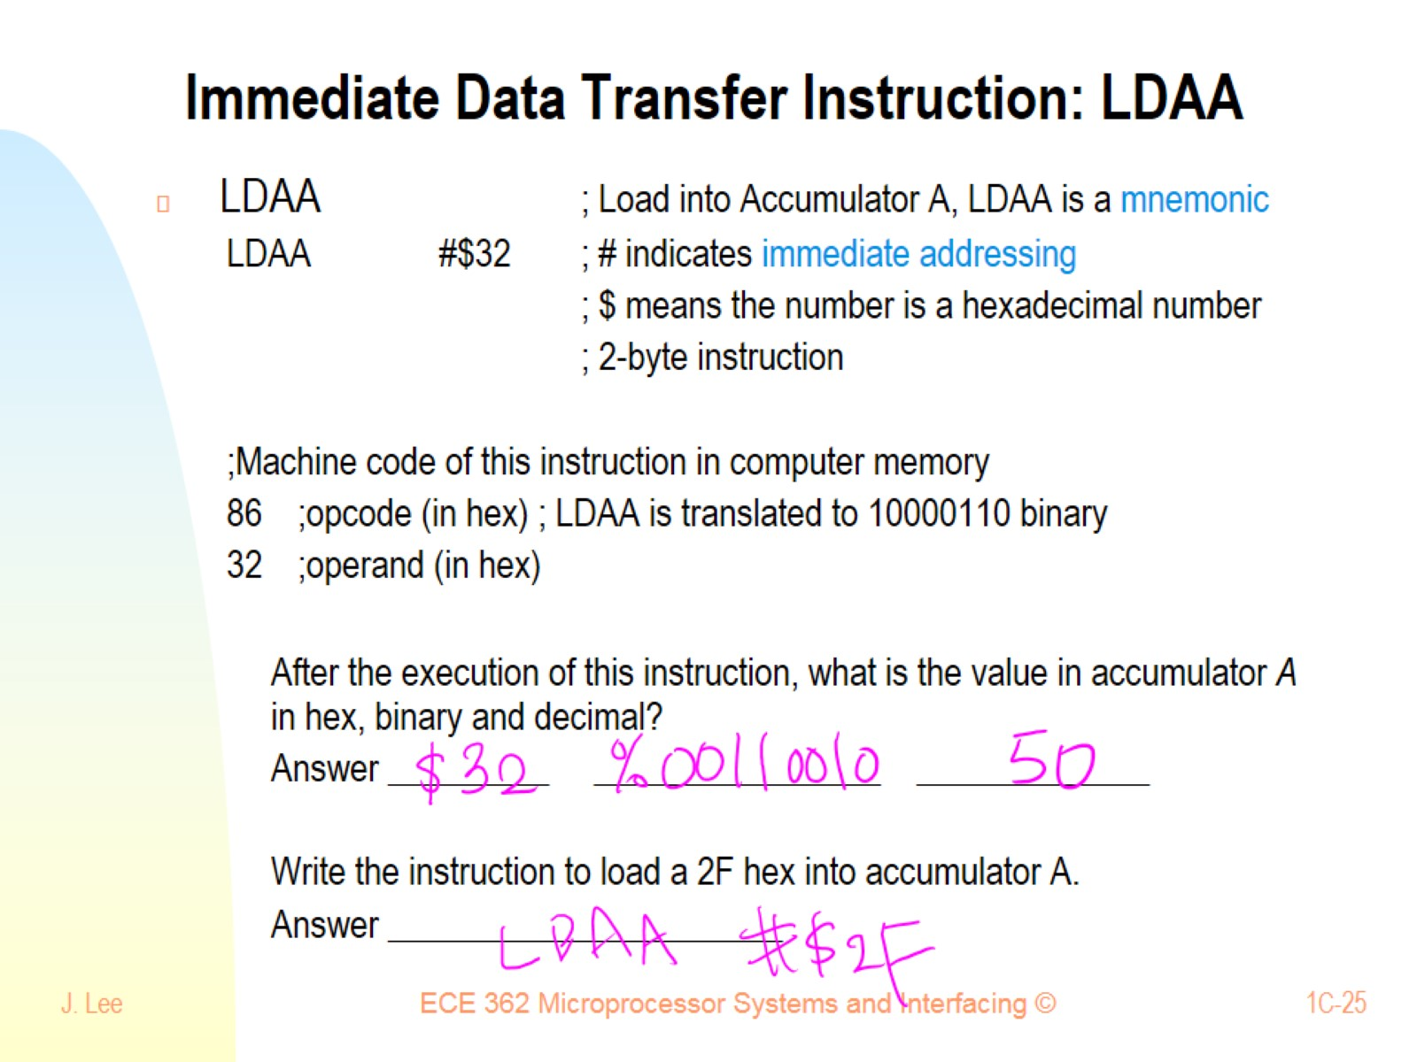
Immediate Data Transfer Instruction: LDAA

Slide 26
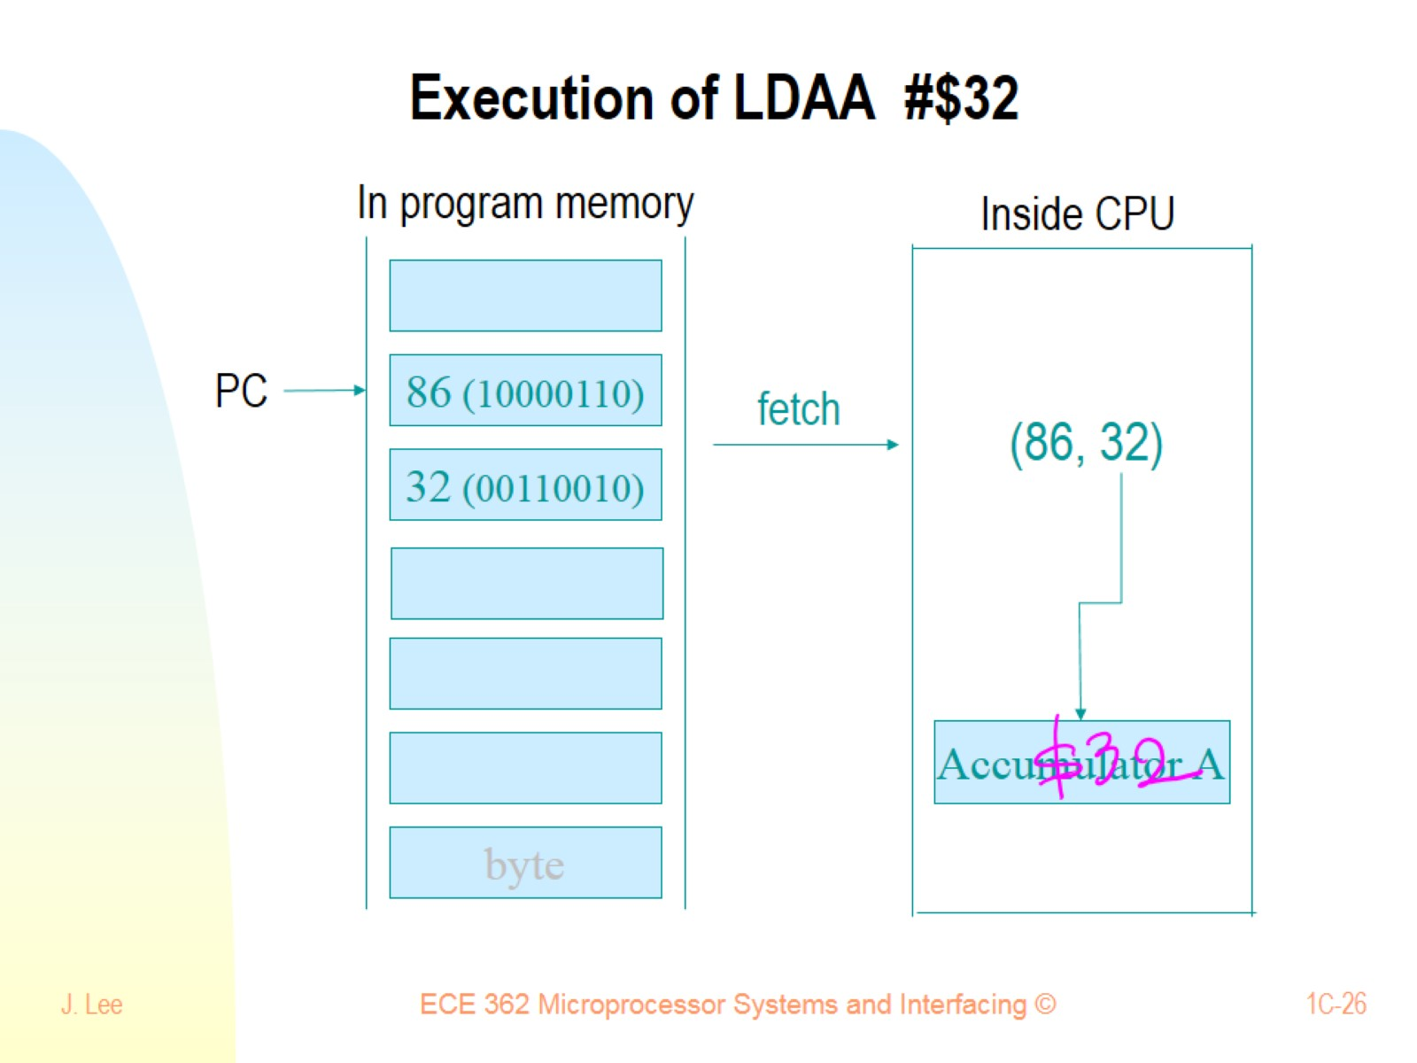
Execution of LDAA #$32

Slide 27
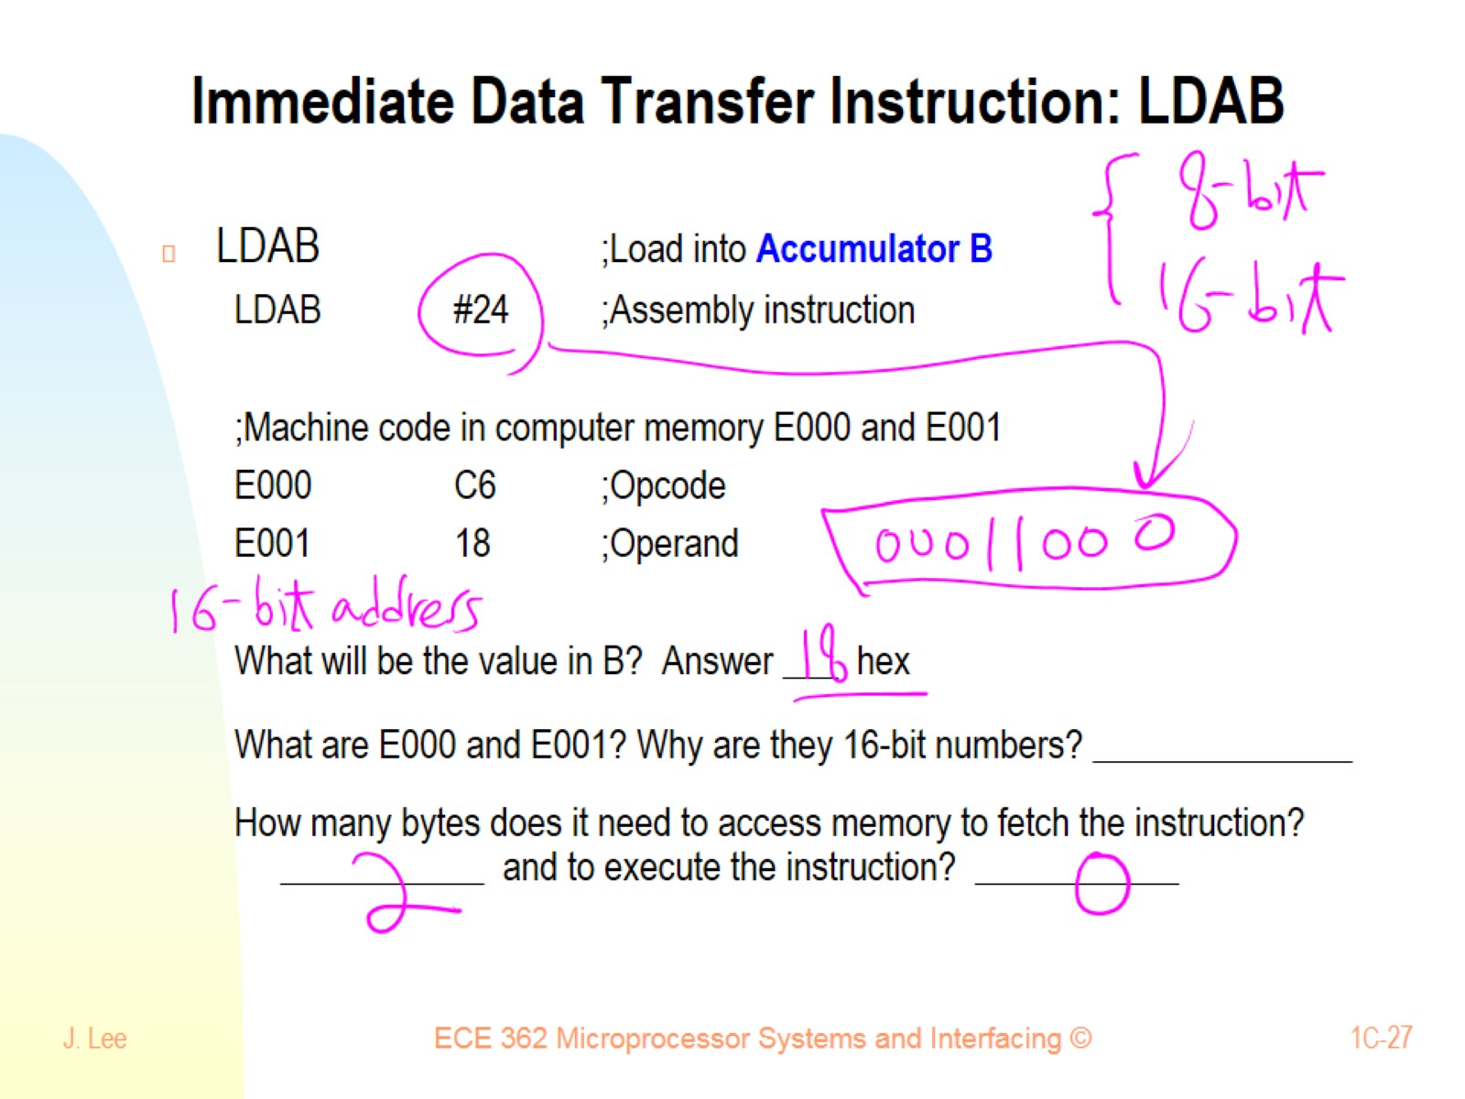
Immediate Data Transfer Instruction: LDAB

Slide 28
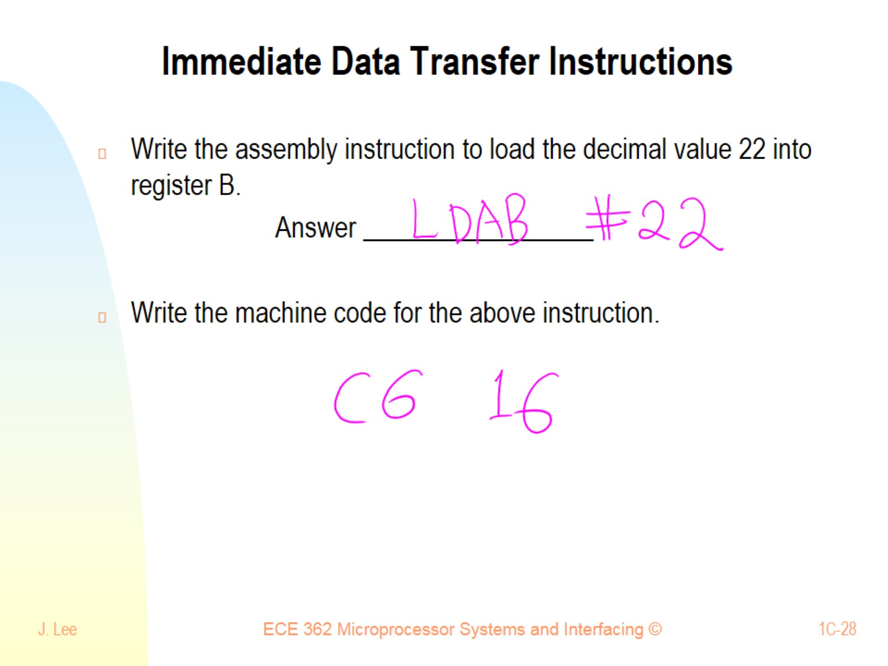
Immediate Data Transfer Instructions

Slide 29
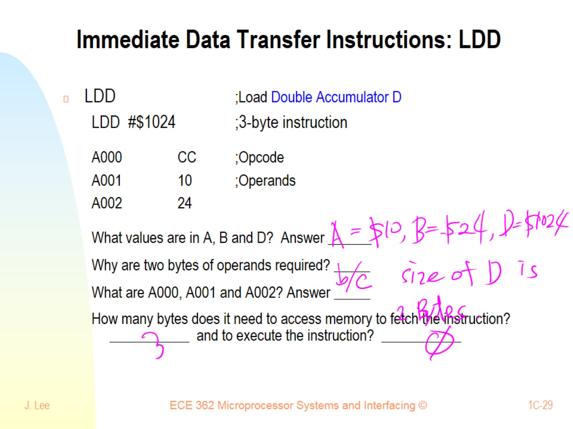
Immediate Data Transfer Instructions: LDD

Slide 30
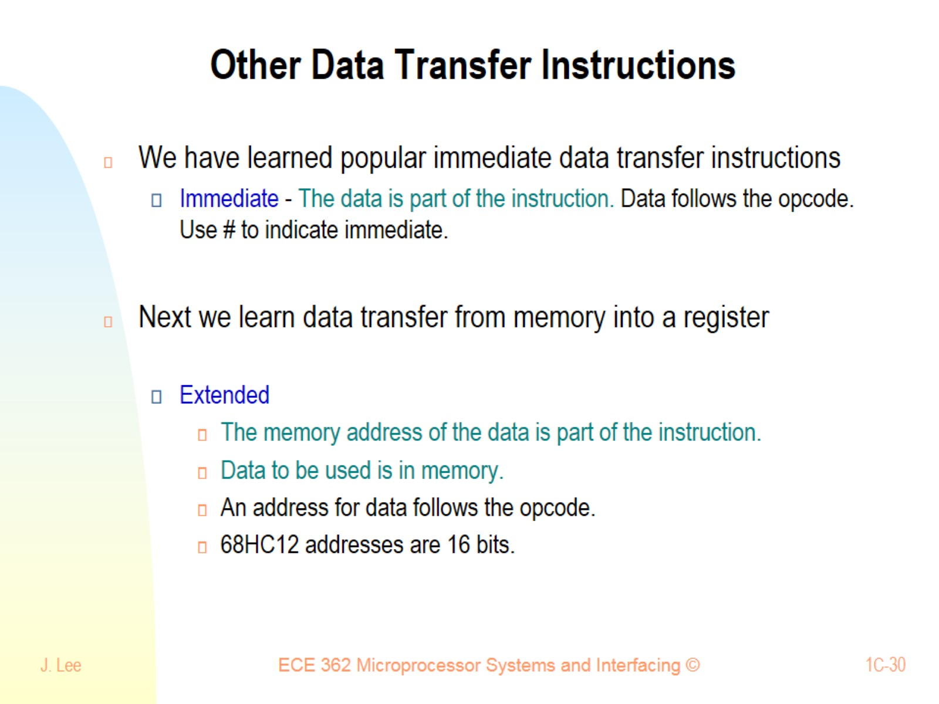
Other Data Transfer Instructions

Slide 31
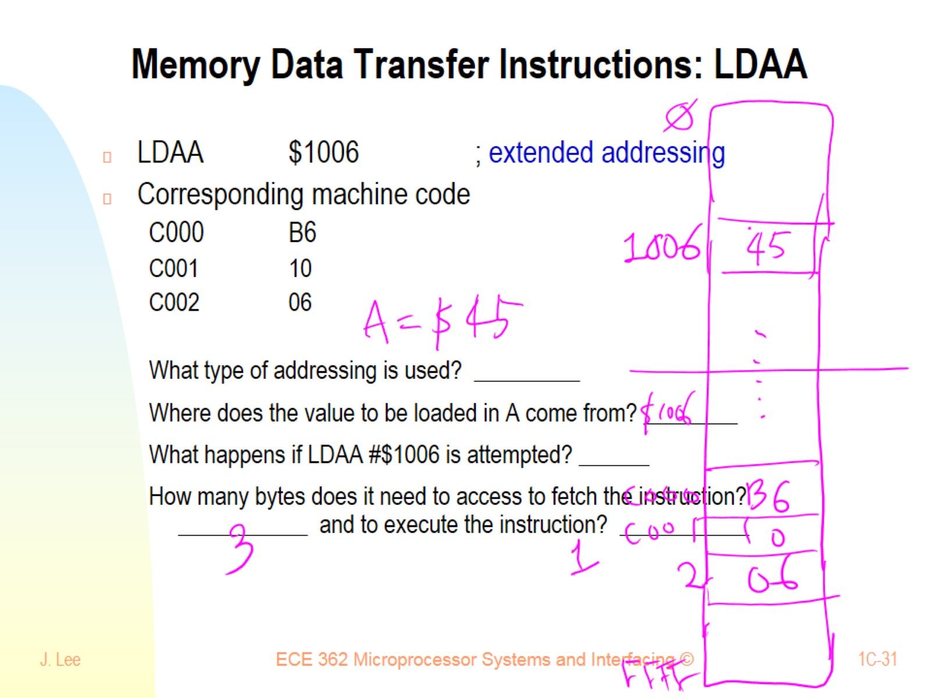
Memory Data Transfer Instructions: LDAA

Slide 32
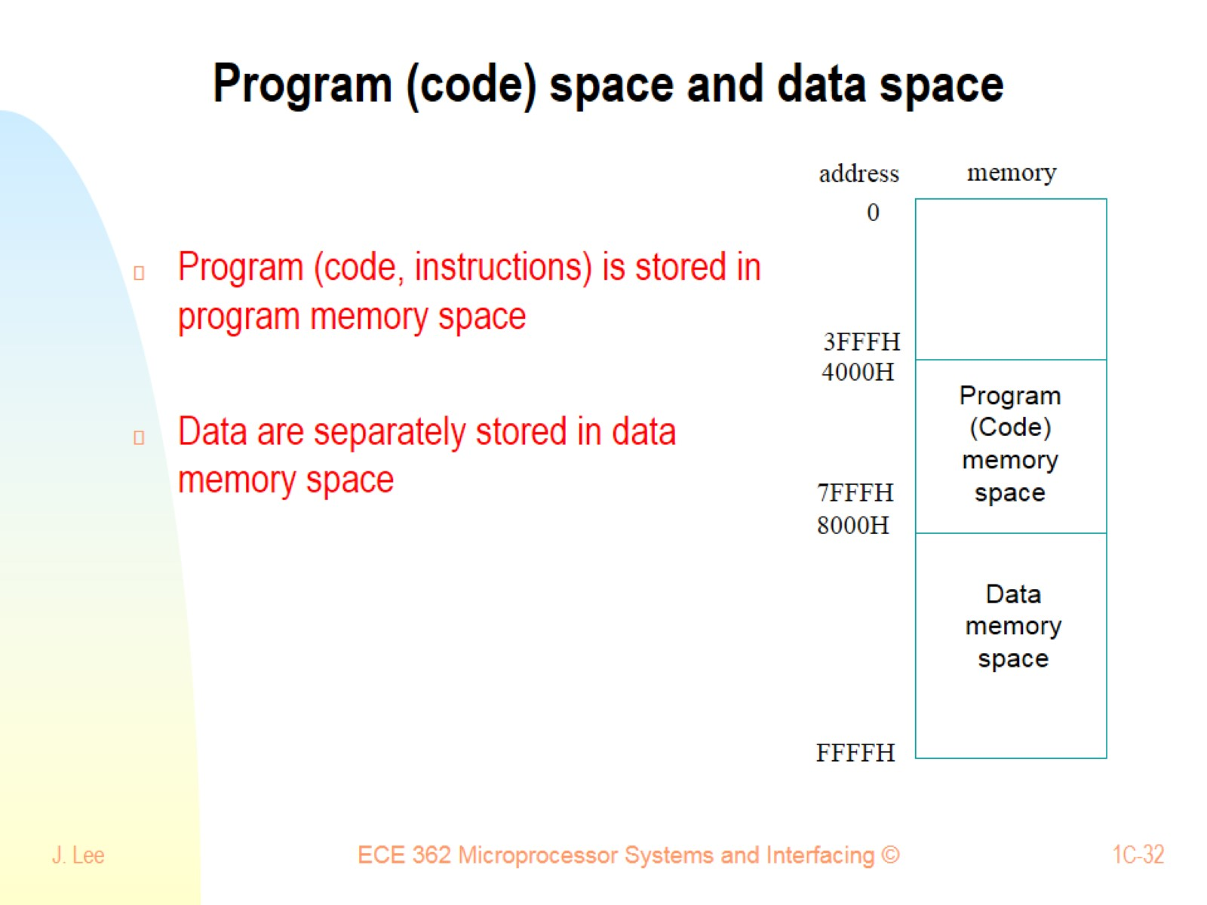
Program (code) space and data space

Slide 33
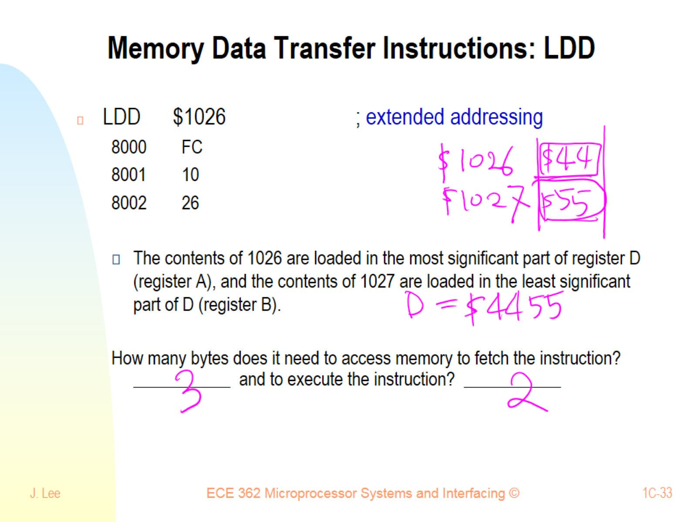
Memory Data Transfer Instructions: LDD

Slide 34
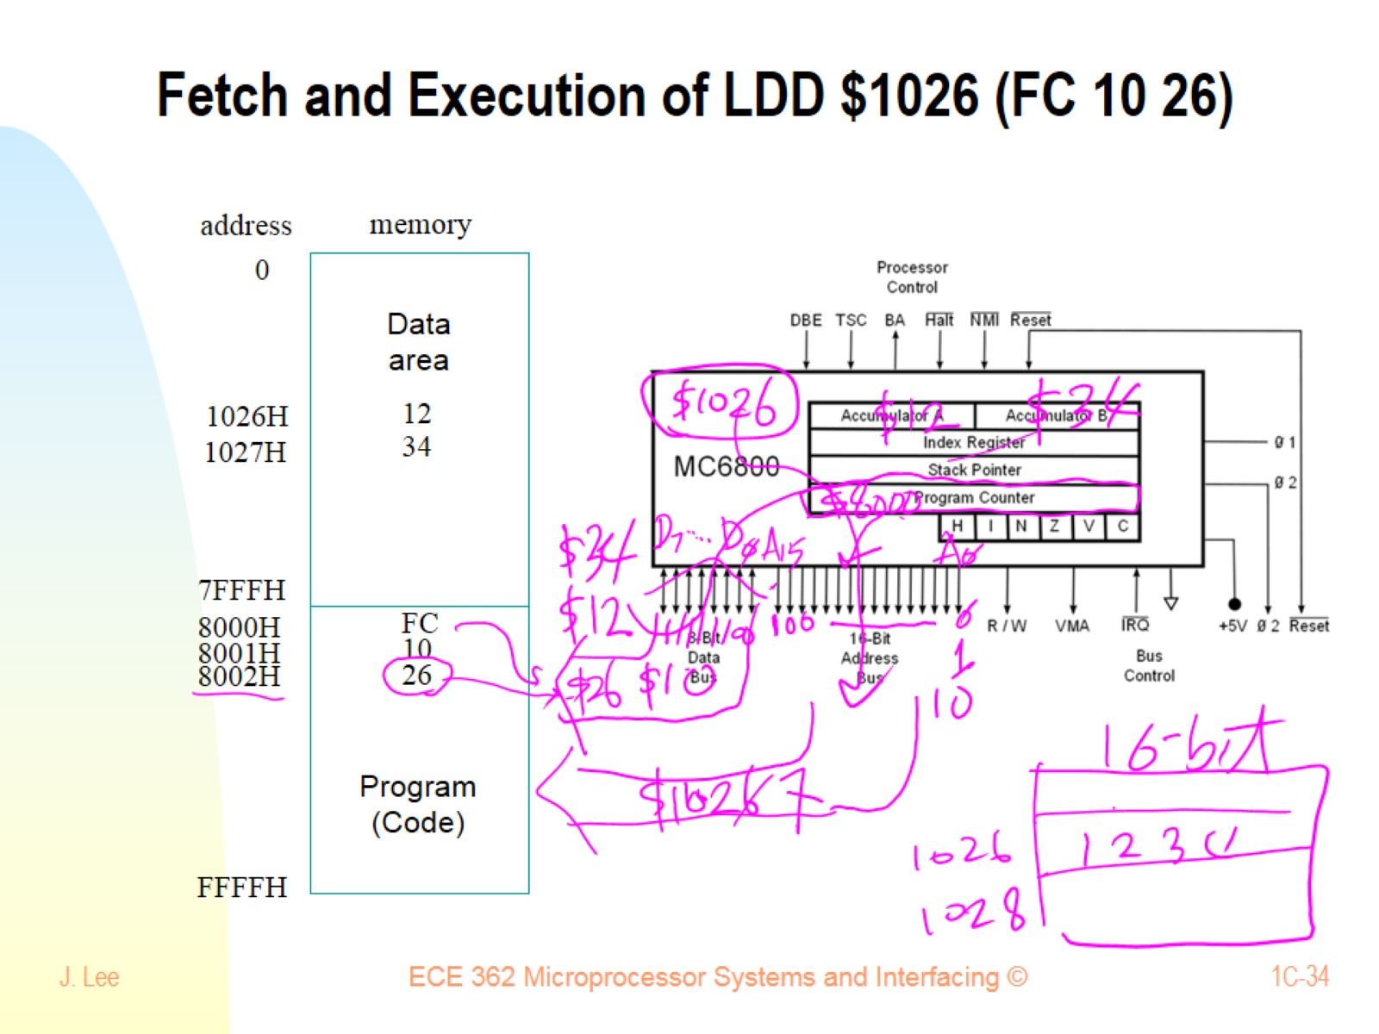
Fetch and Execution of LDD $1026 (FC 10 26)

Slide 35
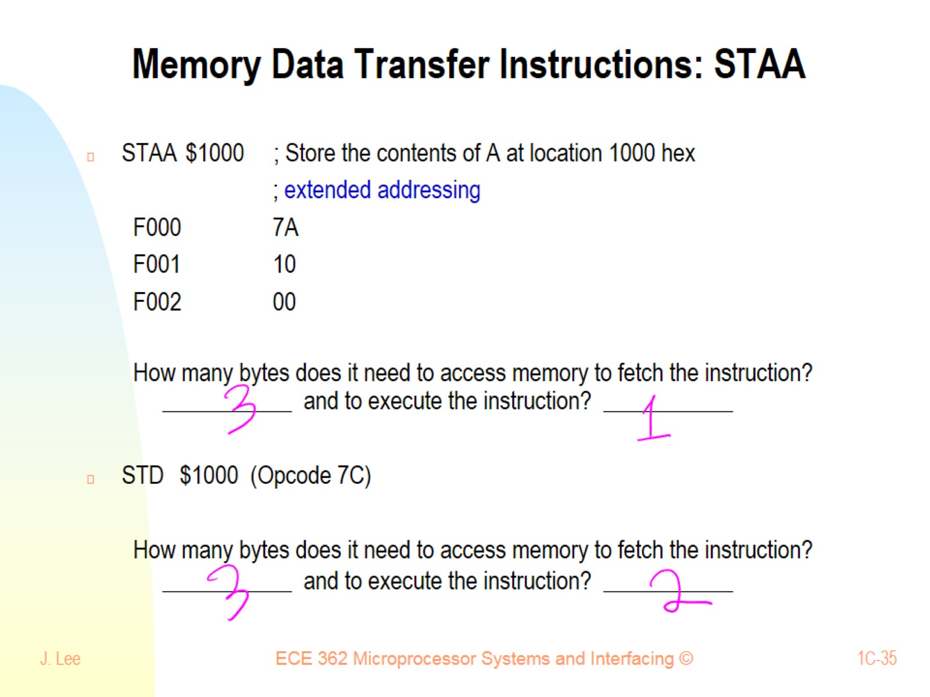
Memory Data Transfer Instructions: STAA

Slide 36
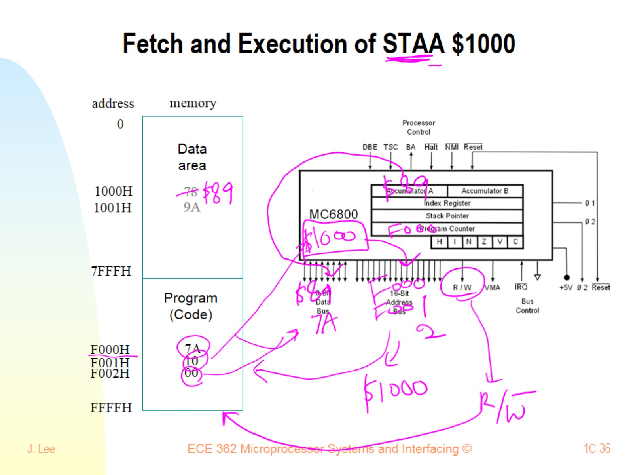
Fetch and Execution of STAA $1000

Slide 37
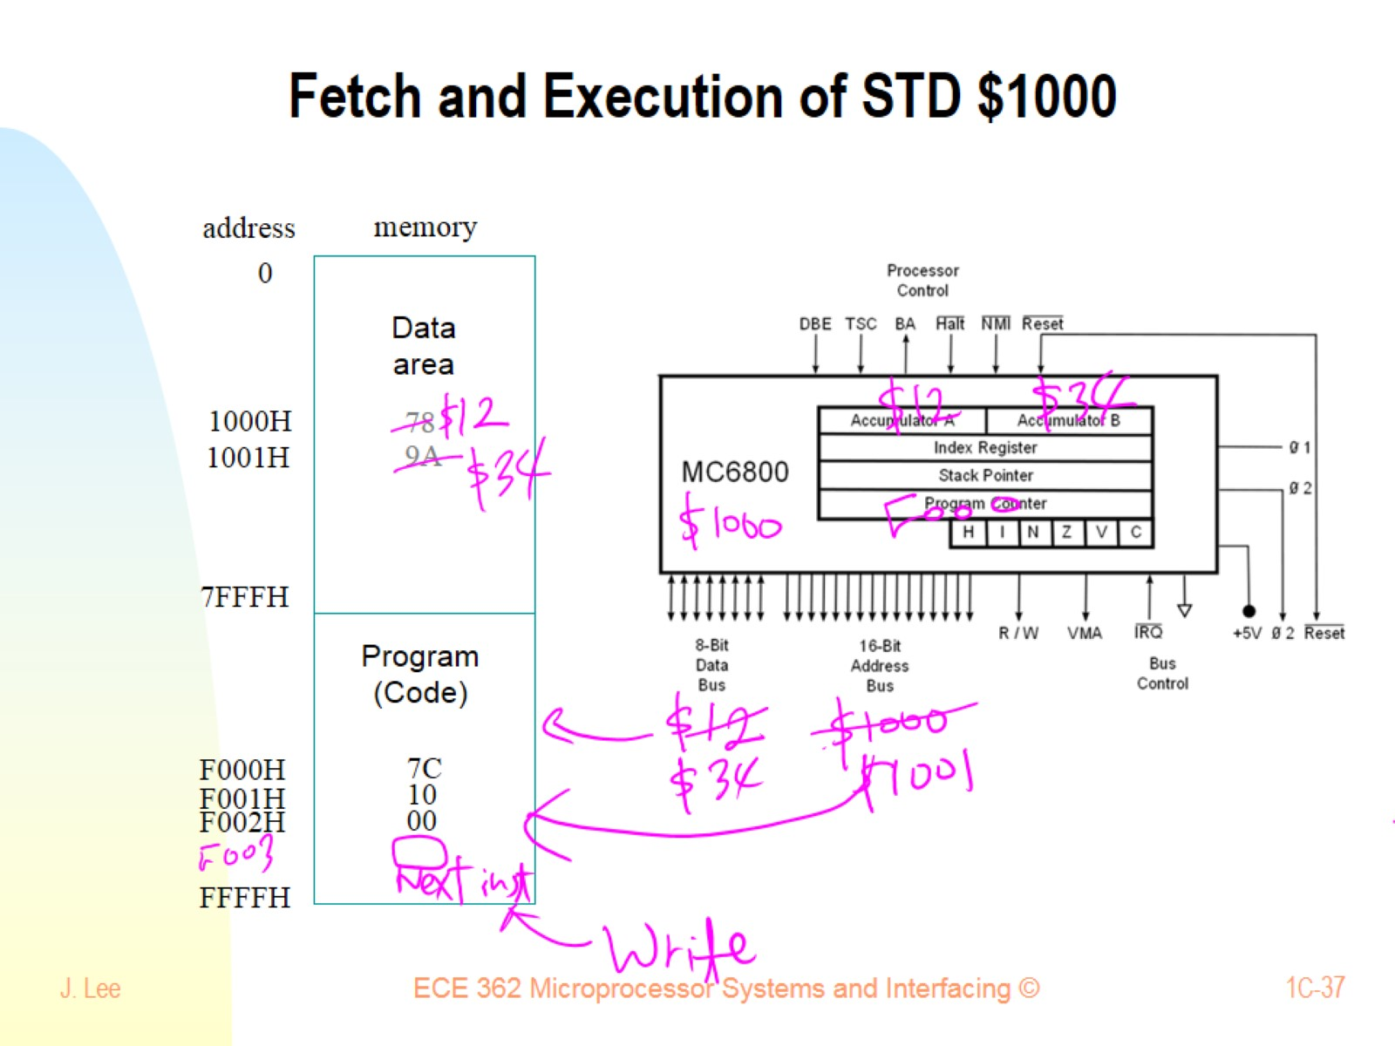
Fetch and Execution of STD $1000

Slide 38
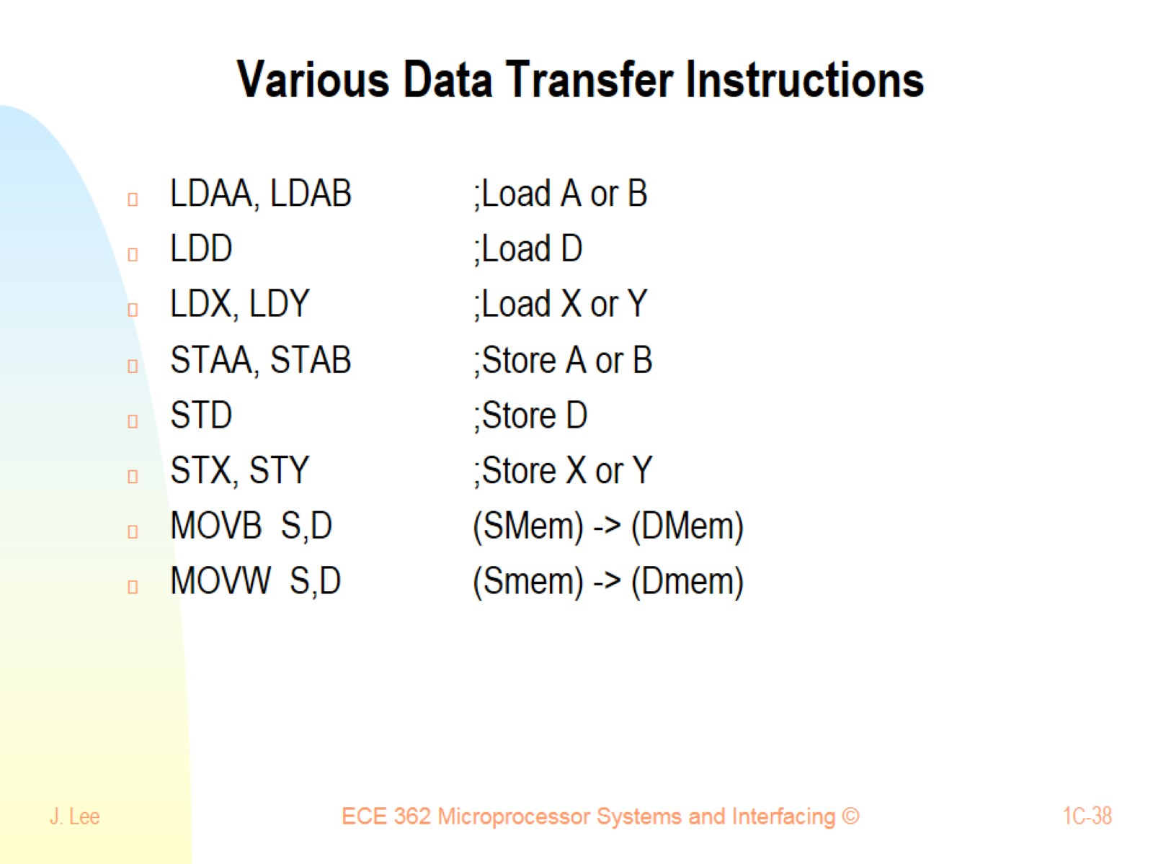
Various Data Transfer Instructions

Slide 39
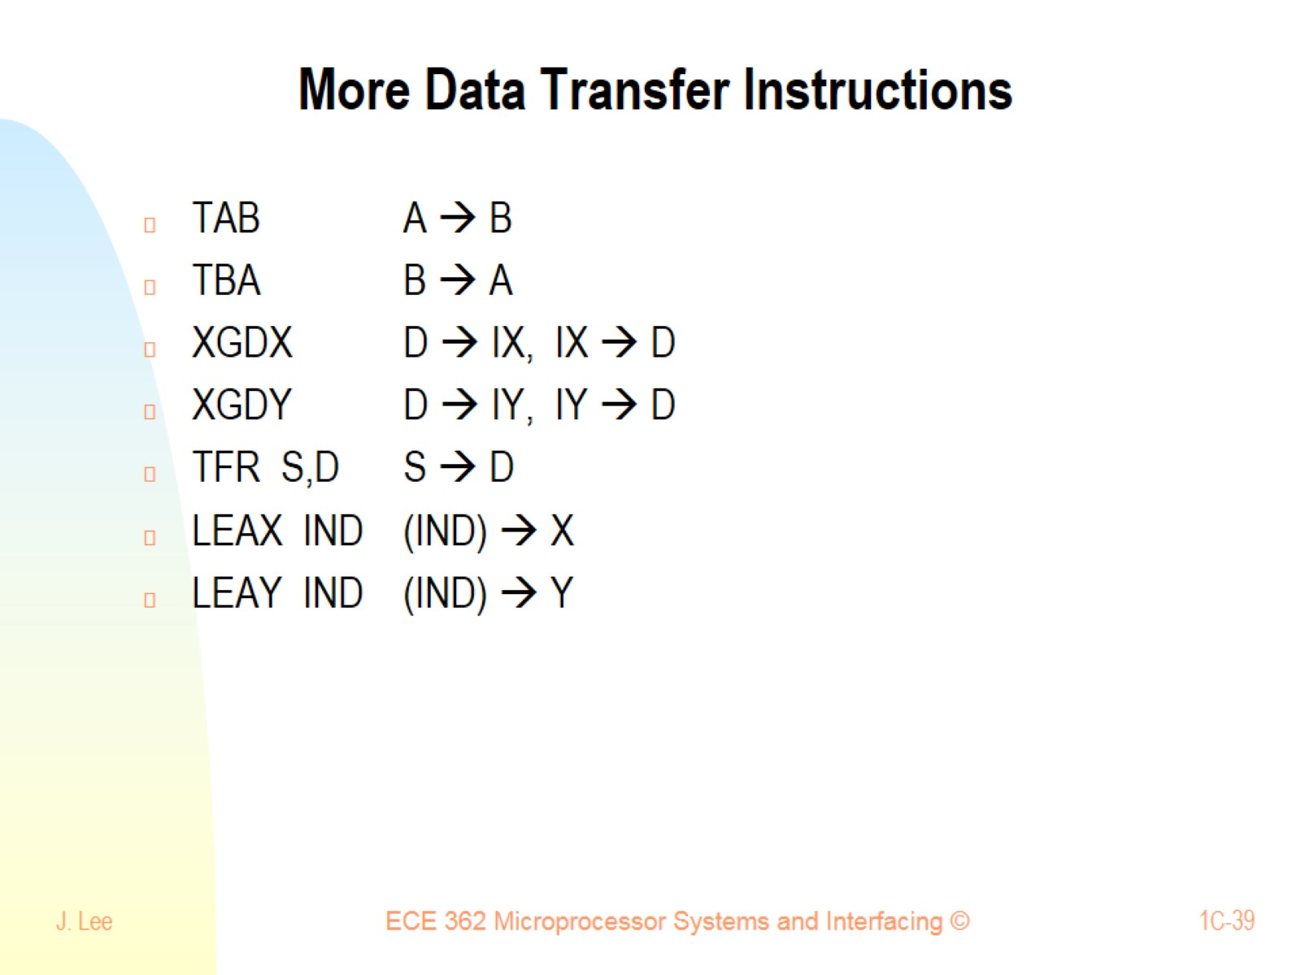
More Data Transfer Instructions

Slide 40
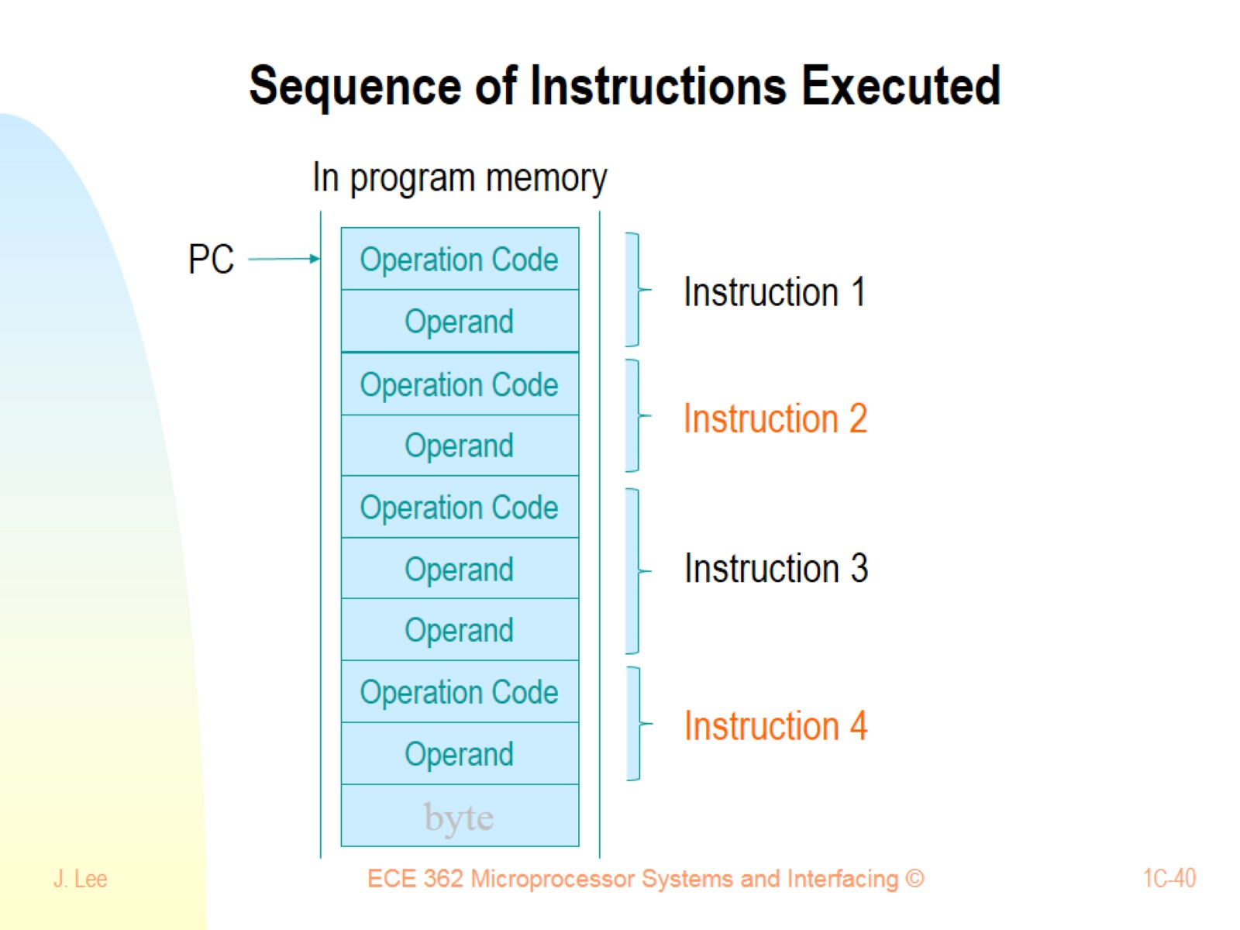
Sequence of Instructions Executed

Slide 41
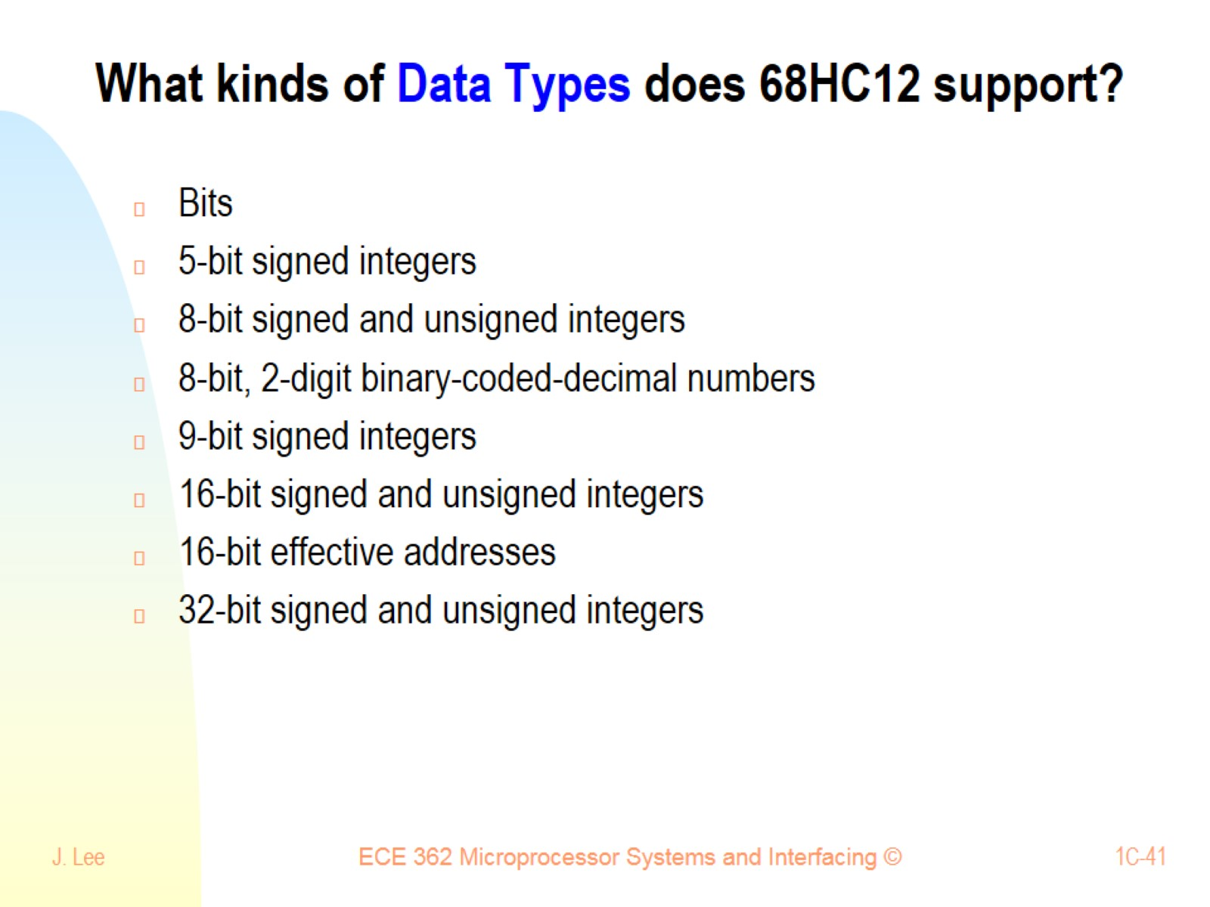
What kinds of Data Types does 68HC12 support?

Slide 42
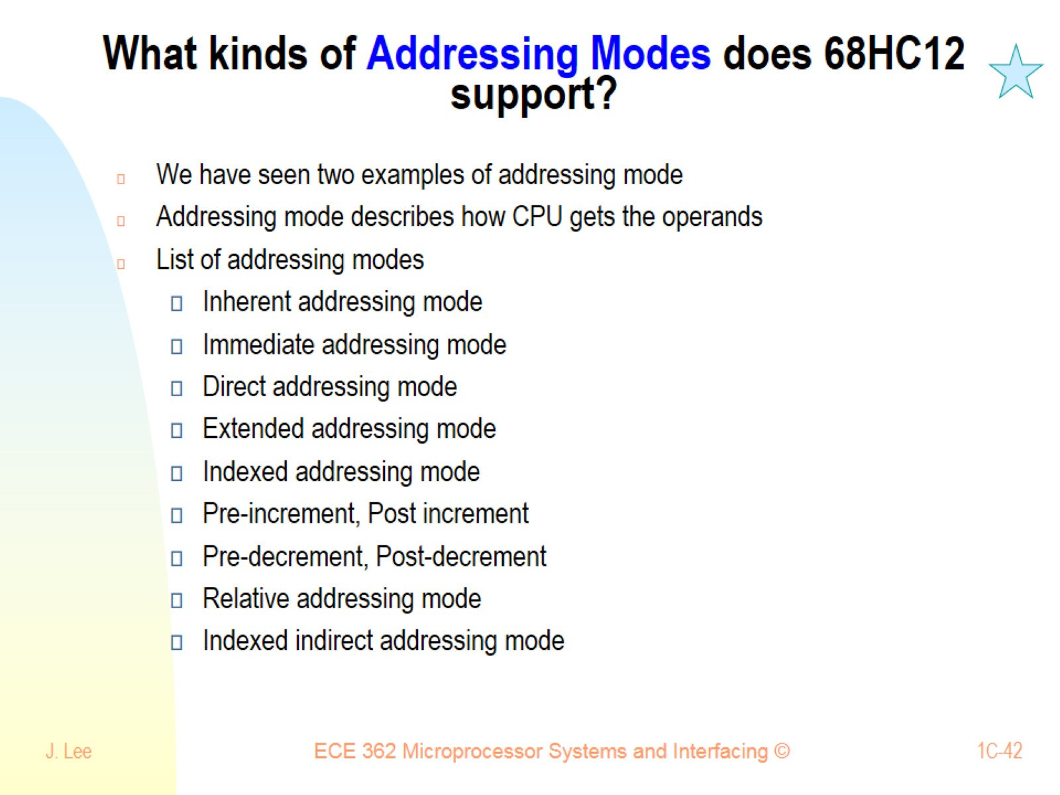
What kinds of Addressing Modes does 68HC12 support?

Slide 43
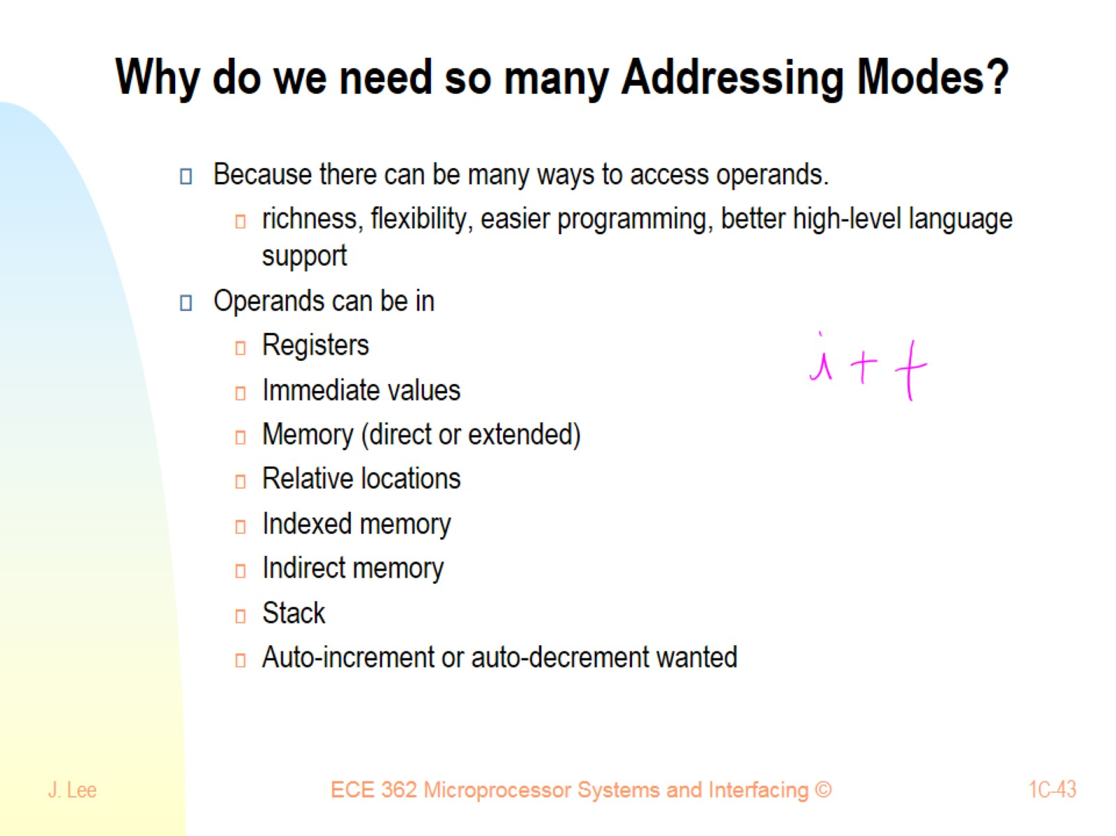
Why do we need so many Addressing Modes?

Slide 44
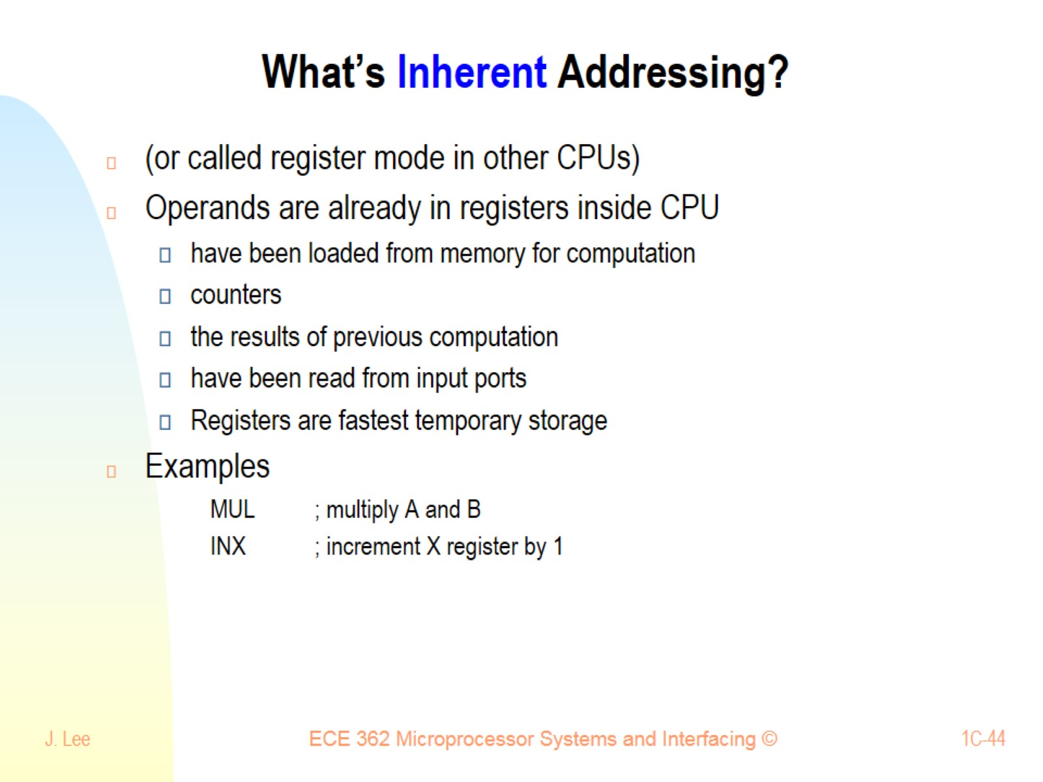
What’s Inherent Addressing?

Slide 45
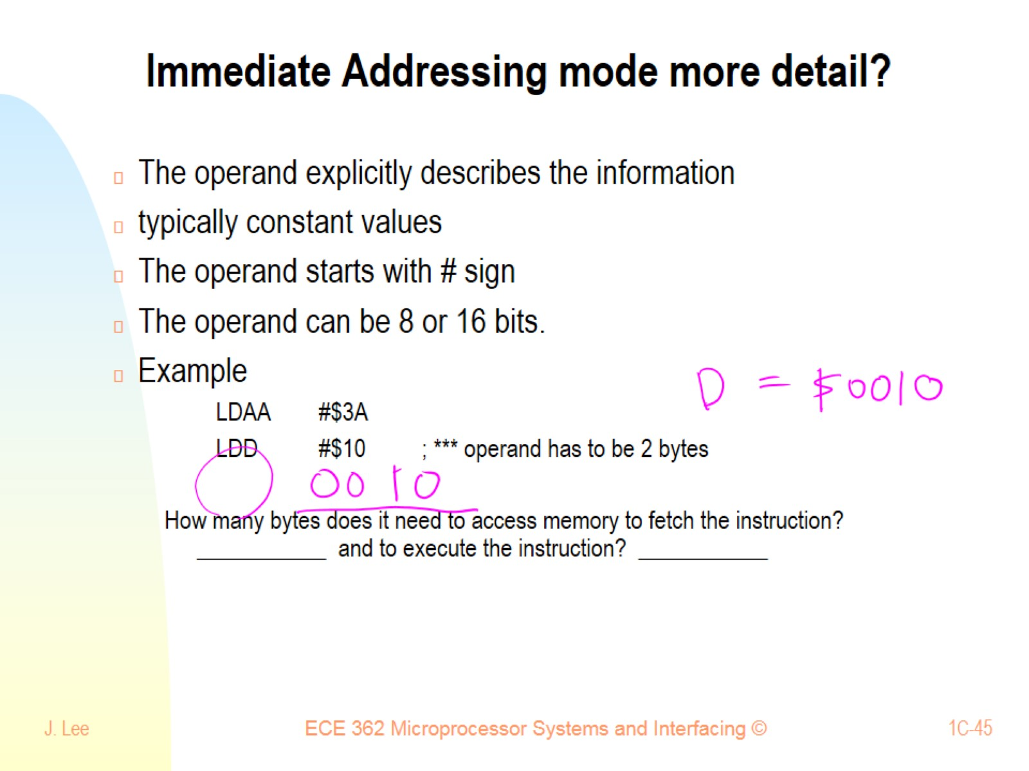
Immediate Addressing mode more detail?

Slide 46
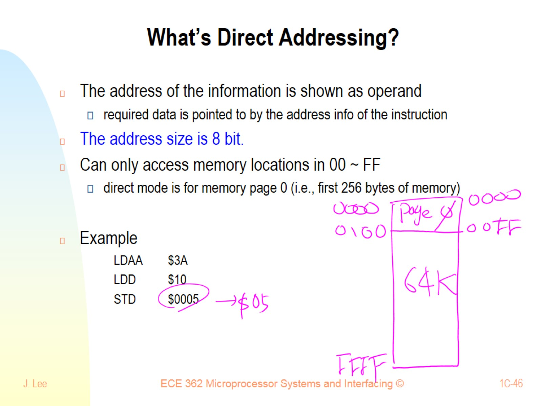
What’s Direct Addressing?

Slide 47
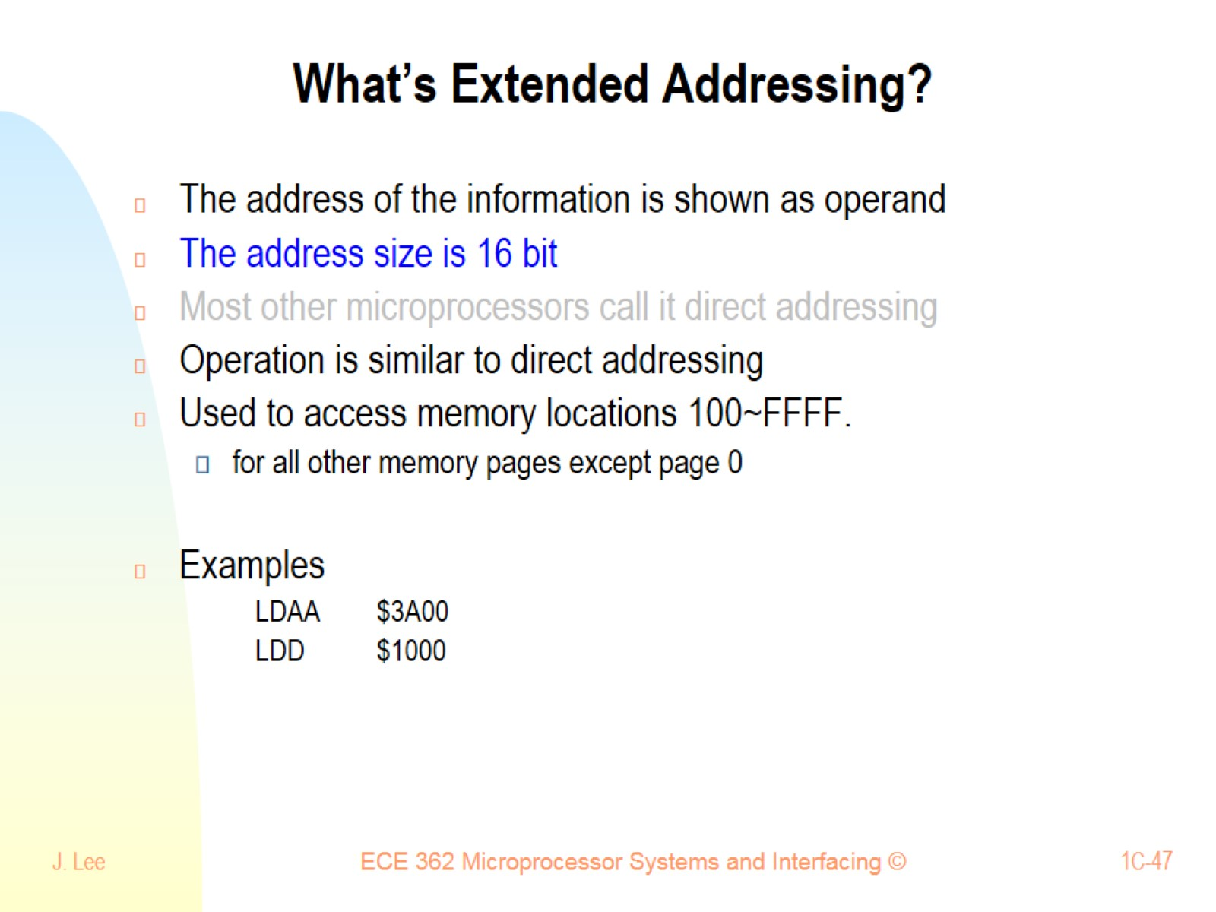
What’s Extended Addressing?

Slide 48
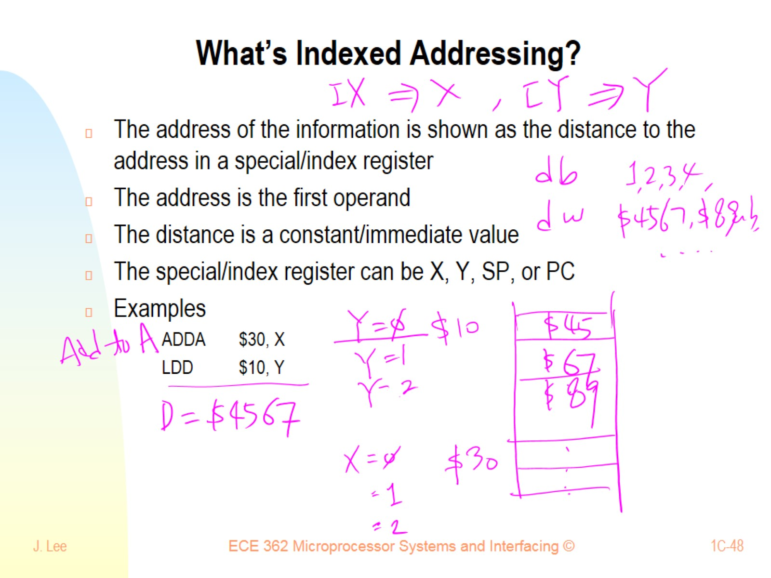
What’s Indexed Addressing?

Slide 49
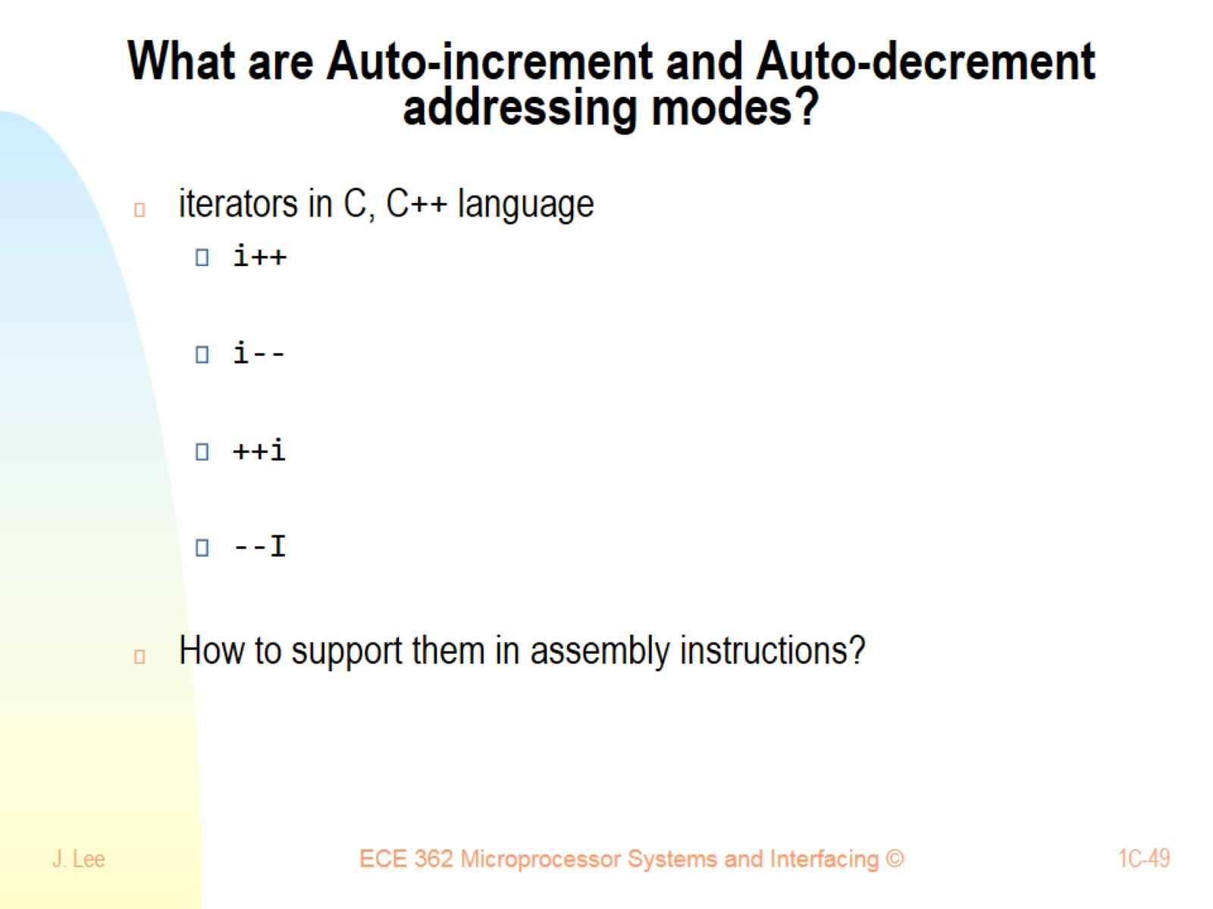
What are Auto-increment and Auto-decrement addressing modes?

Slide 50
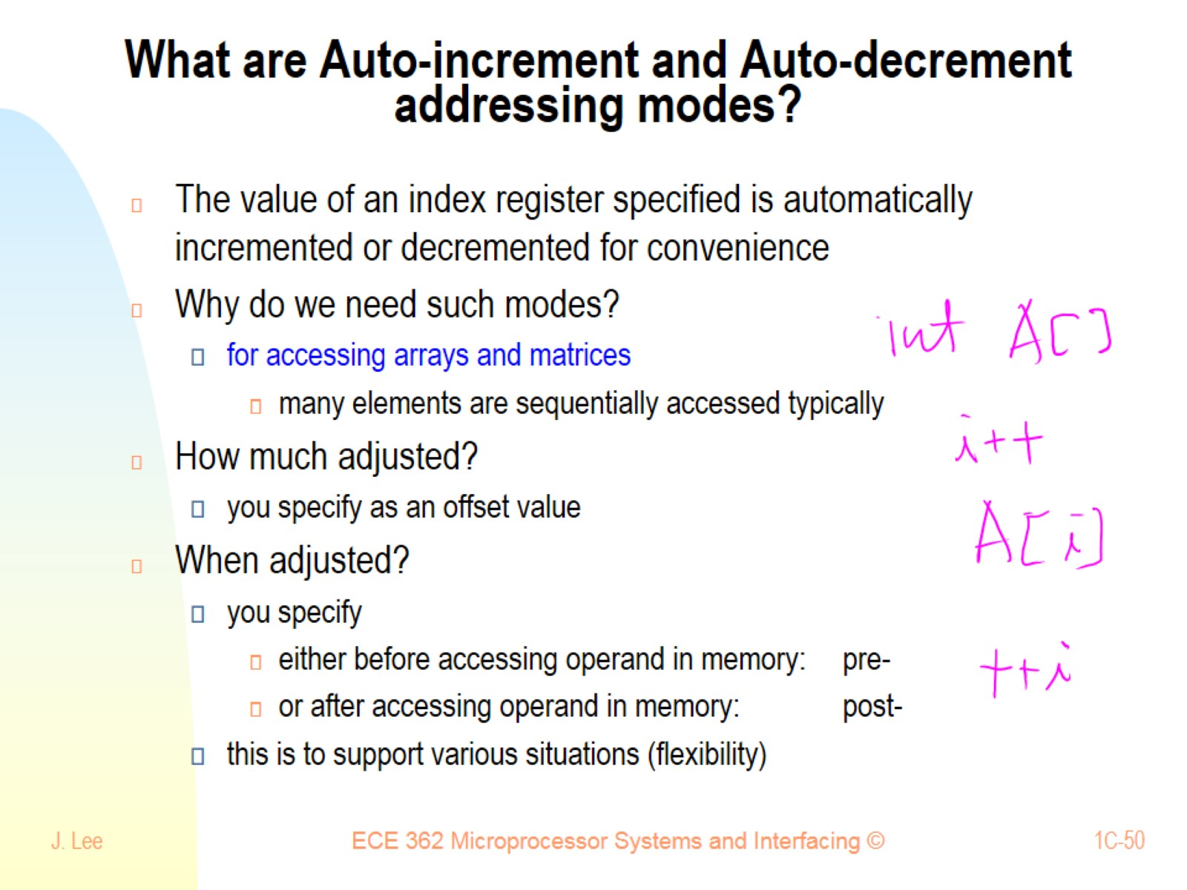
What are Auto-increment and Auto-decrement addressing modes?

Slide 51

What are Pre- and Post- Autoincrement and Autodecrement addressing modes?

Slide 52

What are Autoincrement and Autodecrement?

Slide 53

What is Indexed Indirect Addressing with 16-bit Offset?

Slide 54

What is Indexed Indirect Addressing with D-offset?

Slide 55

What’s Relative Addressing Mode?

Slide 56

8-bit 2’s Complement (Signed) Representation

Slide 57


Slide 58

One mnemonic (inst. type) may have many addressing modes

Slide 59

One mnemonic (inst. type) may have many addressing modes

Slide 60

ADDA 10

Slide 61

How Does the Control Unit Work?

Slide 62

8-bit vs 16-bit data bus

Slide 63

Exercise

Slide 64

Quiz: Addressing Modes/Disassembly

Slide 65

Quiz (cont)

